Slide 1
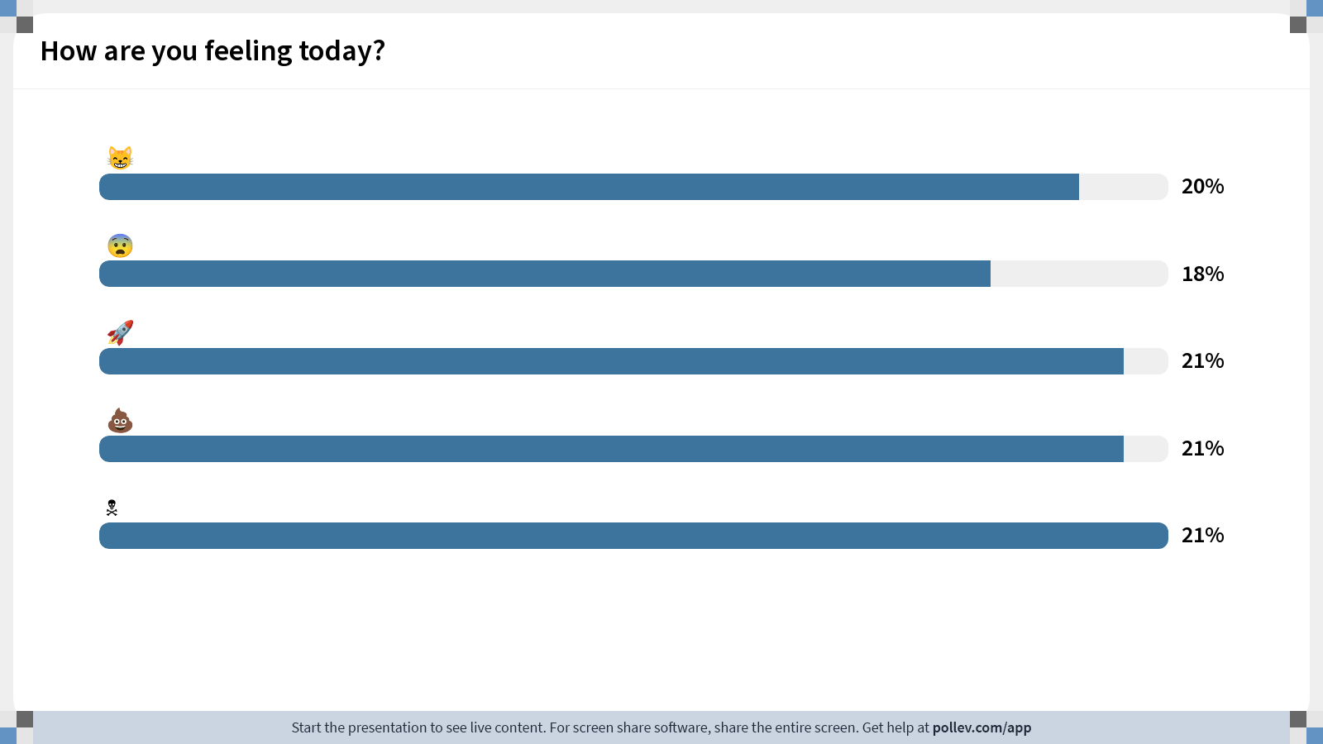
Notes:
Do not modify the notes in this section to avoid tampering with the Poll Everywhere activity. More info at polleverywhere.com/support How are you feeling today?
https://www.polleverywhere.com/multiple_choice_polls/nZZaGNqugEouNBLCX5ogC?state=opened&flow=Default&onscreen=persist

Slide 2
Fundamentals of Ecology
Week 6, Ecology Lecture 2
Cara Brook
February 6, 2024

Slide 3
Let’s recap a bit!
Ecology, generally
Ecology is the study of organisms and their interactions with each other and the environment
We use models to formalize hypotheses about these interactions and test those hypotheses against data
We can ask questions at many ecological scales: individual, population, metapopulation, community, ecosystem
Population growth, specifically
We can model population growth as geometric in discrete time or exponential in continuous time
Logistic growth models describe density-dependent growth rates that limit population growth at some specified carrying capacity
Logistic growth models imply a stable equilibrium where the population size (N) is equal to the carrying capacity (K)
Fisheries have used this model to attempt to define a maximum sustainable harvest rate (MSY) to guide policy, but it has performed poorly because the models are not realistic
One shortcoming of the simple logistic growth model is a failure to include both environmental and demographic stochasticity

Slide 4
Let’s recap a bit!
Ecology, generally
Ecology is the study of organisms and their interactions with each other and the environment
We use models to formalize hypotheses about these interactions and test those hypotheses against data
We can ask questions at many ecological scales: individual, population, metapopulation, community, ecosystem
Population growth, specifically
We can model population growth as geometric in discrete time or exponential in continuous time
Logistic growth models describe density-dependent growth rates that limit population growth at some specified carrying capacity
Logistic growth models imply a stable equilibrium where the population size (N) is equal to the carrying capacity (K)
Despite the dire predictions of Malthus in the late 1700s, most human populations do not appear to yet be approaching carrying capacity

Slide 5
Let’s recap a bit!
Ecology, generally
Ecology is the study of organisms and their interactions with each other and the environment
We use models (especially population models) to formalize hypotheses about these interactions and test those hypotheses against data
We can ask questions at many ecological scales: individual, population, metapopulation, community, ecosystem
Population growth, specifically
We can model population growth as geometric in discrete time or exponential in continuous time
Logistic growth models describe density-dependent growth rates that limit population growth at some specified carrying capacity
Logistic growth models imply a stable equilibrium where the population size (N) is equal to the carrying capacity (K)
Despite the dire predictions of Malthus in the late 1700s, most human populations do not appear to yet be approaching carrying capacity

Slide 6
Let’s recap a bit!
Ecology, generally
Ecology is the study of organisms and their interactions with each other and the environment
We use models (especially population models) to formalize hypotheses about these interactions and test those hypotheses against data
We can ask questions at many ecological scales: individual, population, metapopulation, community, ecosystem
Population growth, specifically
We can model population growth as geometric in discrete time or exponential in continuous time
Logistic growth models describe density-dependent growth rates that limit population growth at some specified carrying capacity
Logistic growth models imply a stable equilibrium where the population size (N) is equal to the carrying capacity (K)
Despite the dire predictions of Malthus in the late 1700s, most human populations do not appear to yet be approaching carrying capacity

Slide 7
Let’s recap a bit!
Ecology, generally
Ecology is the study of organisms and their interactions with each other and the environment
We use models (especially population models) to formalize hypotheses about these interactions and test those hypotheses against data
We can ask questions at many ecological scales: individual, population, metapopulation, community, ecosystem
Population growth, specifically
We can model population growth as geometric in discrete time or exponential in continuous time
Logistic growth models describe density-dependent growth rates that limit population growth at some specified carrying capacity
Logistic growth models imply a stable equilibrium where the population size (N) is equal to the carrying capacity (K)
Despite the dire predictions of Malthus in the late 1700s, most human populations do not appear to yet be approaching carrying capacity

Slide 8
Let’s recap a bit!
Ecology, generally
Ecology is the study of organisms and their interactions with each other and the environment
We use models (especially population models) to formalize hypotheses about these interactions and test those hypotheses against data
We can ask questions at many ecological scales: individual, population, metapopulation, community, ecosystem
Population growth, specifically
We can model population growth as geometric in discrete time or exponential in continuous time
We can estimate growth rates by ‘fitting’ a model to data
Logistic growth models describe density-dependent growth rates that limit population growth at some specified carrying capacity
Logistic growth models imply a stable equilibrium where the population size (N) is equal to the carrying capacity (K)
Despite the dire predictions of Malthus in the late 1700s, most human populations do not appear to yet be approaching carrying capacity

Slide 9
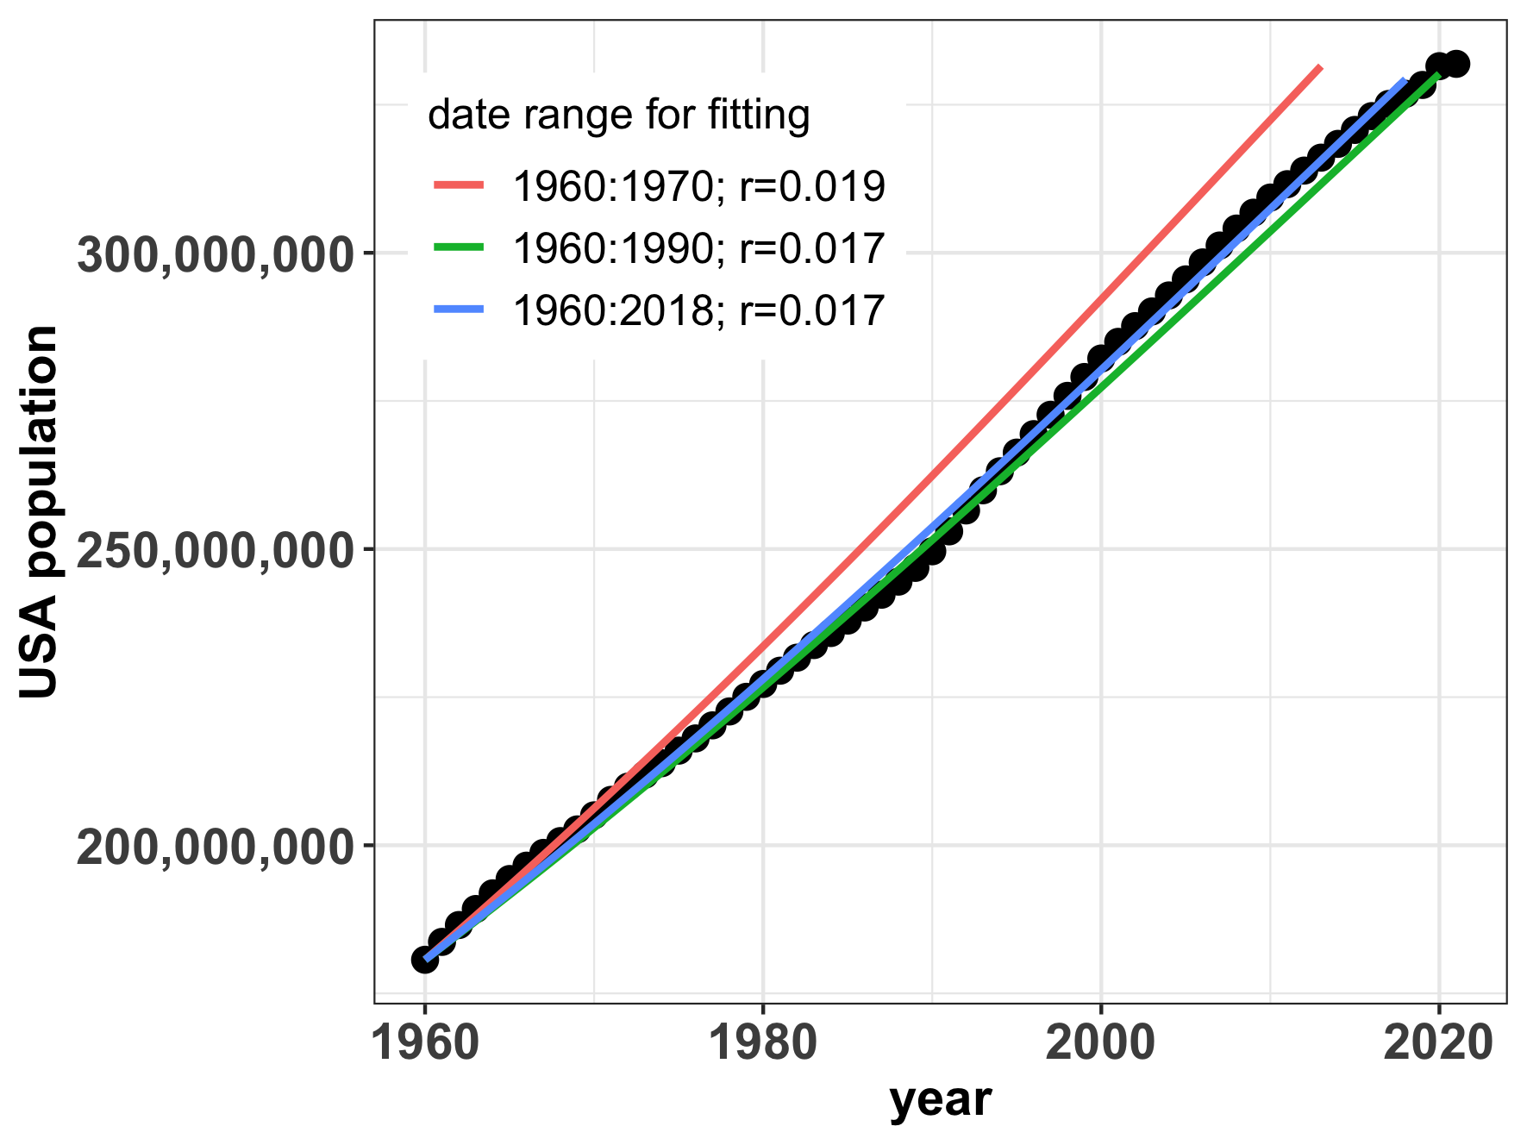
We can estimate growth rates by ‘fitting’ a model to data
Notes:
Fits to data from earlier years only overestimate current population growth rates

Slide 10
We can estimate growth rates by ‘fitting’ a model to data
US growth rates slowed over the time period!
Model fits to data from earlier years overestimate current population growth rates
Notes:
Fits to data from earlier years only overestimate current population growth rates

Slide 11
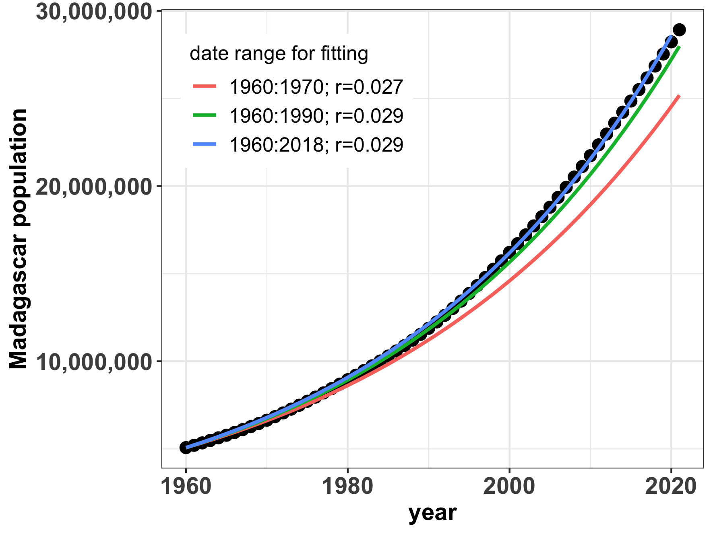
We can estimate growth rates by ‘fitting’ a model to data

Slide 12
We can estimate growth rates by ‘fitting’ a model to data
Madagascar growth rates accelerated over the time period!
Model fits to data from earlier years underestimate current population growth rates
Notes:
Fits to data from earlier years only underestimate current population trends

Slide 13
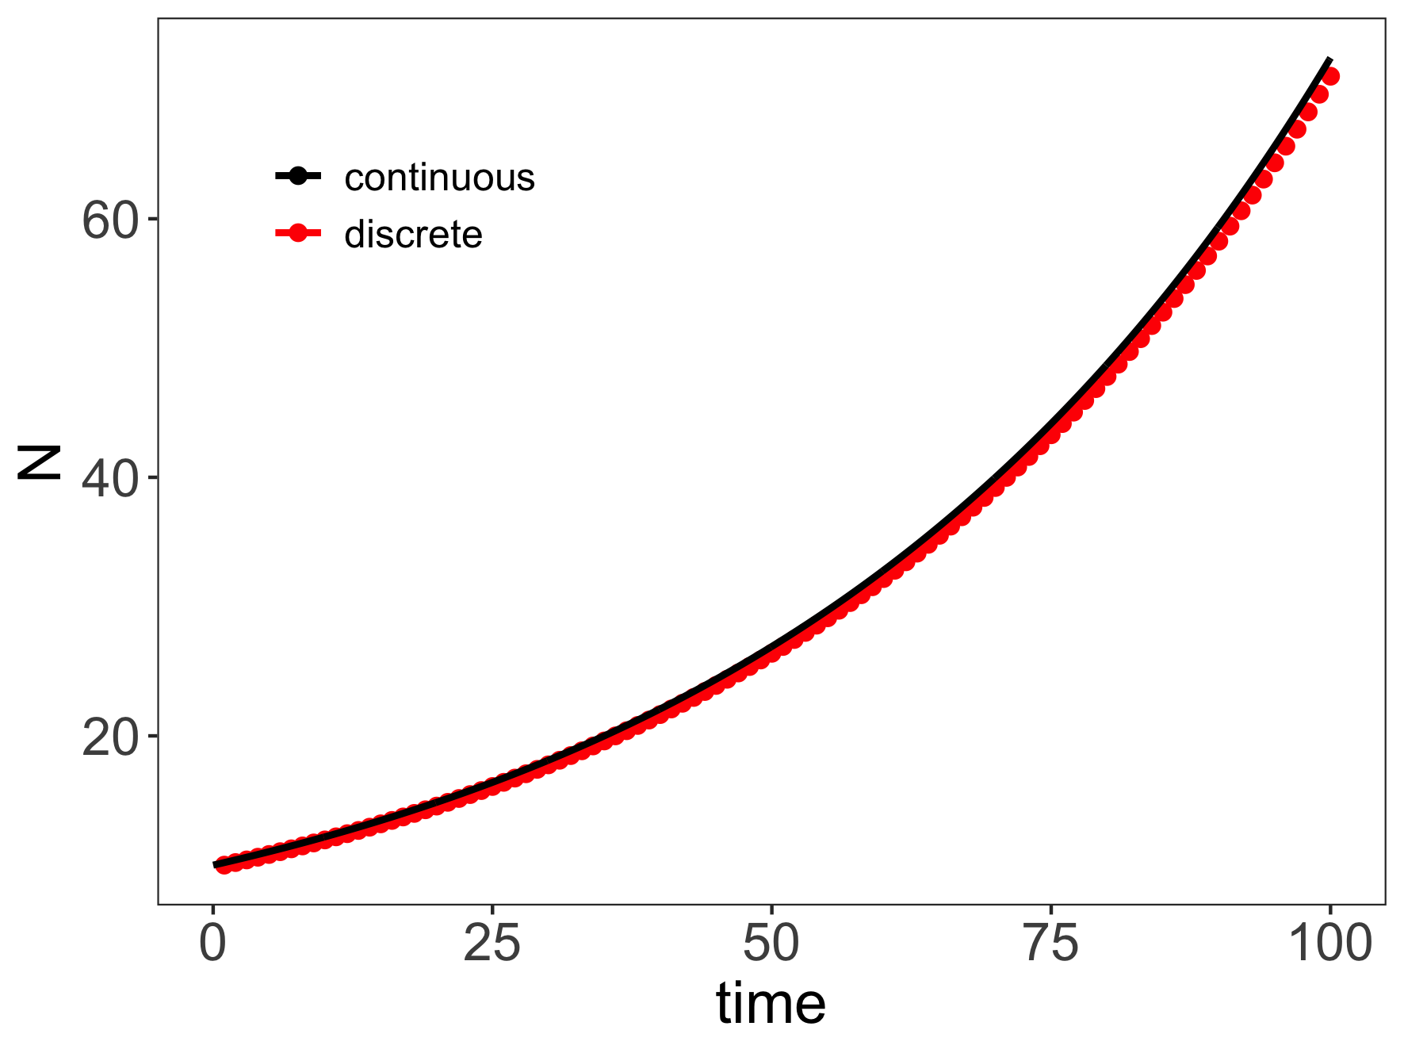
Both geometric and exponential growth are unchecked.

Slide 14
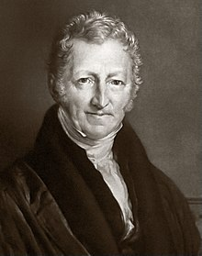
Malthus proposed some limits to population growth
“[. . . ] the power of population is indefinitely greater than the power in the earth to produce subsistence for man. Population, when unchecked, increases in a geometrical ratio. Subsistence increases only in an arithmetical ratio. A slight acquaintance with numbers will shew the immensity of the first power in comparison of the second. By that law of our nature which makes food necessary to the life of man, the effects of these two unequal powers must be kept equal. This implies a strong and constantly operating check on population from the difficulty of subsistence. This difficulty must fall somewhere; and must necessarily be severely felt by a large portion of mankind.”
- Thomas Malthus (1798)
An Essay on the Principle of Population as it Effects the Future Improvement of Society,
With Remarks on the Speculations of Mr Godwin, Mr. Condorcet and Other Writers
Notes:
Thomas Malthus. English cleric in the late 1700s, early 1800s.
Published the book anonymously.

Slide 15
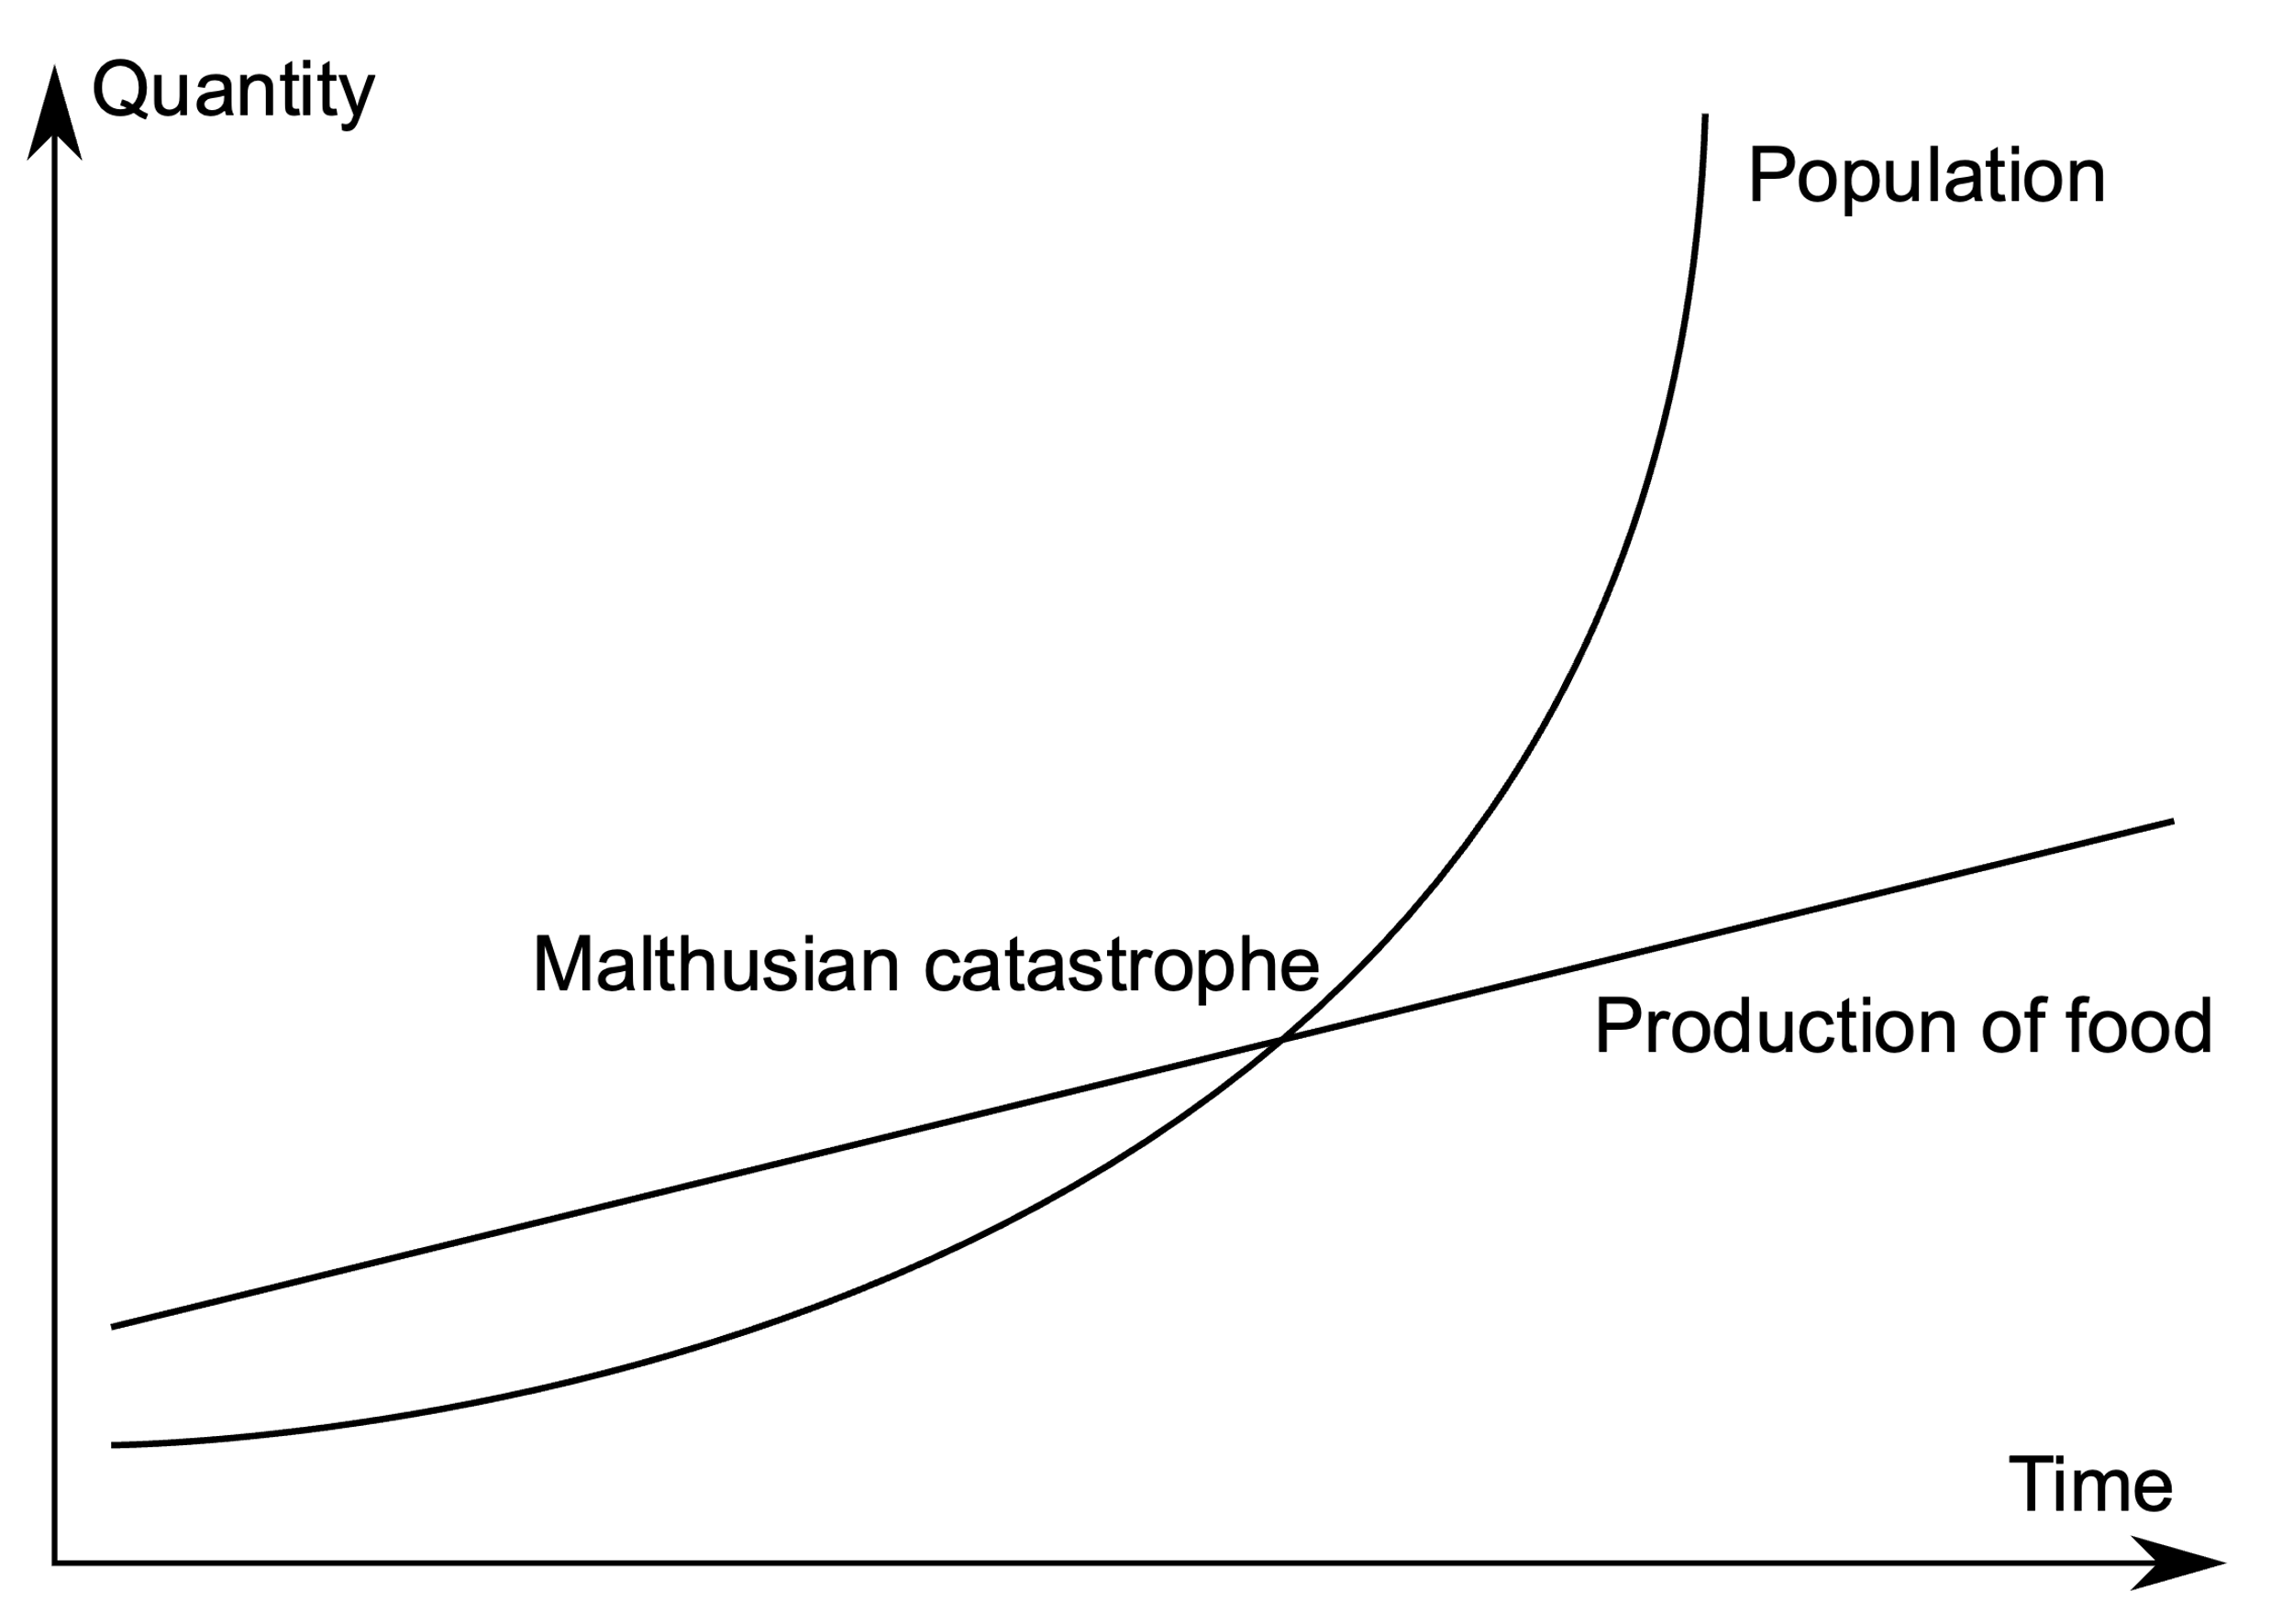
Malthus proposed some limits to population growth
- Thomas Malthus (1798)
An Essay on the Principle of Population as it Effects the Future Improvement of Society,
With Remarks on the Speculations of Mr. Godwin, Mr. Condorcet and Other Writers
Notes:
Thomas Malthus. English cleric in the late 1700s, early 1800s.
Inspired strong reactions. Darwin was inspired. Marx was disgusted
Marx claimed that poverty and hunger was a result of the capitalist economy, not population growth. He argued that food supplies would keep pace with population growth if wealth was distributed fairly
Malthus offered no basis for his arithmetical ratio for food, and there were occasions in which food had increased geometrically to match a geometric rise in population (as in North America)
Indeed, the industrial revolution proved that human food production could keep pace with population growth

Slide 16
Malthus proposed some limits to population growth
Problem!
No basis for assumption of arithmetical ratio for food.
- Thomas Malthus (1798)
An Essay on the Principle of Population as it Effects the Future Improvement of Society,
With Remarks on the Speculations of Mr. Godwin, Mr. Condorcet and Other Writers
Notes:
Thomas Malthus. English cleric in the late 1700s, early 1800s.
Inspired strong reactions. Darwin was inspired. Marx was disgusted
Marx claimed that poverty and hunger was a result of the capitalist economy, not population growth. He argued that food supplies would keep pace with population growth if wealth was distributed fairly
Malthus offered no basis for his arithmetical ratio for food, and there were occasions in which food had increased geometrically to match a geometric rise in population (as in North America)
Indeed, the industrial revolution proved that human food production could keep pace with population growth
Led him to write a second essay that proposed all kinds of ways to keep population in check: famine, war, abortion, delayed marriage. Very anti-charity
An Essay on the Principle of Population, or a View of its Past and Present Effects
on Human Happiness, With an Enquiry Into Our Prospects Respecting the Future Removal or Mitigation of the Evils Which It Occasions

Slide 17
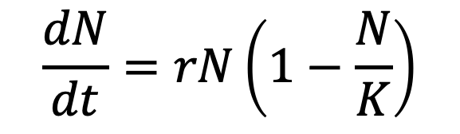
Logistic growth equation
“We shall not insist on the hypothesis of geometric progression, given that it can hold only in very special
circumstances; for example, when a fertile territory of almost unlimited size happens to be inhabited by people…”
- Pierre-Francois Verhulst (1838)
$$\frac{dN}{dt}=rN\left(1−\frac{N}{K}\right)$$

Slide 18
Logistic growth equation
“We shall not insist on the hypothesis of geometric progression, given that it can hold only in very special
circumstances; for example, when a fertile territory of almost unlimited size happens to be inhabited by people…”
- Pierre-Francois Verhulst (1838)
$$\frac{dN}{dt}=rN\left(1−\frac{N}{K}\right)$$
population size
intrinsic growth rate
carrying capacity
Population growth slows as abundance approaches carrying capacity.
Population growth is density-dependent.

Slide 19
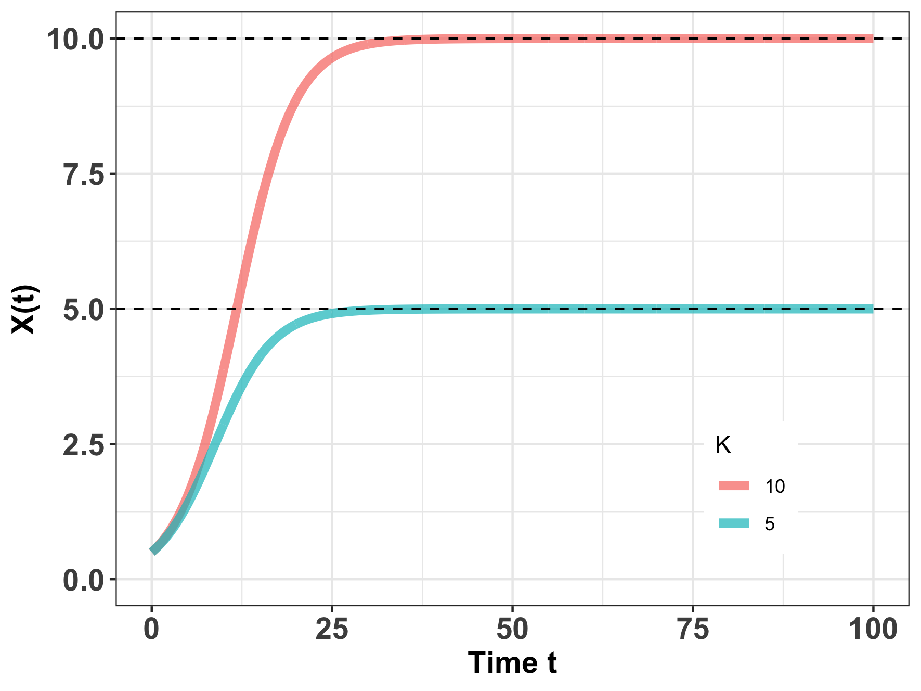
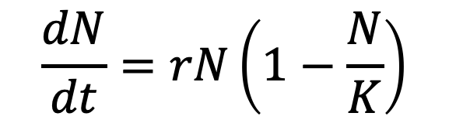
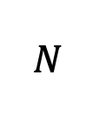
Logistic growth equation
$$\frac{dN}{dt}=rN\left(1−\frac{N}{K}\right)$$
Population growth slows to 0 as N approaches K, or – in other words – as the total population size approaches carrying capacity.
$$N$$
Notes:
Ecology – interaction of organisms with each other (population) and their environment (sets K)
R vs. K selected species

Slide 20
Logistic growth equation
$$\frac{dN}{dt}=rN\left(1−\frac{N}{K}\right)$$
Carrying capacity=
maximum population size an environment can sustain indefinitely.
$$N$$
Notes:
Ecology – interaction of organisms with each other (population) and their environment (sets K)
Food, shelter, water
Can CHANGE!

Slide 21
Logistic growth equation
$$\frac{dN}{dt}=rN\left(1−\frac{N}{K}\right)$$
Carrying capacity=
maximum population size an environment can sustain indefinitely.
Ecology = organisms interacting with each other and the environment
$$N$$
Notes:
Ecology – interaction of organisms with each other (population) and their environment (sets K)
Food, shelter, water
Can CHANGE!

Slide 22
Logistic growth equation
$$\frac{dN}{dt}=rN\left(1−\frac{N}{K}\right)$$
Carrying capacity=
maximum population size an environment can sustain indefinitely.
Ecology = organisms interacting with each other and the environment
K can change!
$$N$$
Notes:
Ecology – interaction of organisms with each other (population) and their environment (sets K)
Food, shelter, water
Can CHANGE!

Slide 23
Logistic growth equation
$$\frac{dN}{dt}=rN\left(1−\frac{N}{K}\right)$$
Carrying capacity=
maximum population size an environment can sustain indefinitely.
Ecology = organisms interacting with each other and the environment
K can change!
‘r’ vs. ‘K’-selected species
$$N$$
Notes:
Ecology – interaction of organisms with each other (population) and their environment (sets K)
Food, shelter, water
Can CHANGE!

Slide 24
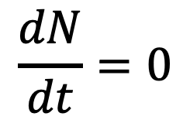
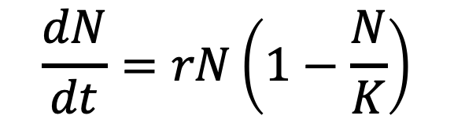
Logistic growth and equilibrium
$$\frac{dN}{dt}=rN\left(1−\frac{N}{K}\right)$$
$$\frac{dN}{dt}=0$$
When population size is not changing, the population is said to be at equilibrium.
$$N$$

Slide 25

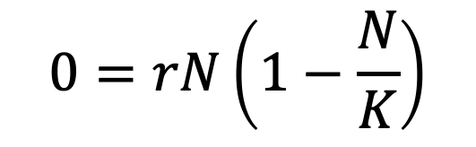
Logistic growth and equilibrium
$$\frac{dN}{dt}=rN\left(1−\frac{N}{K}\right)$$
$$\frac{dN}{dt}=0$$
$$0=rN\left(1−\frac{N}{K}\right)$$
$$N$$
$$N=K$$
A little algebra shows that the population at carrying capacity is at equilibrium.

Slide 26
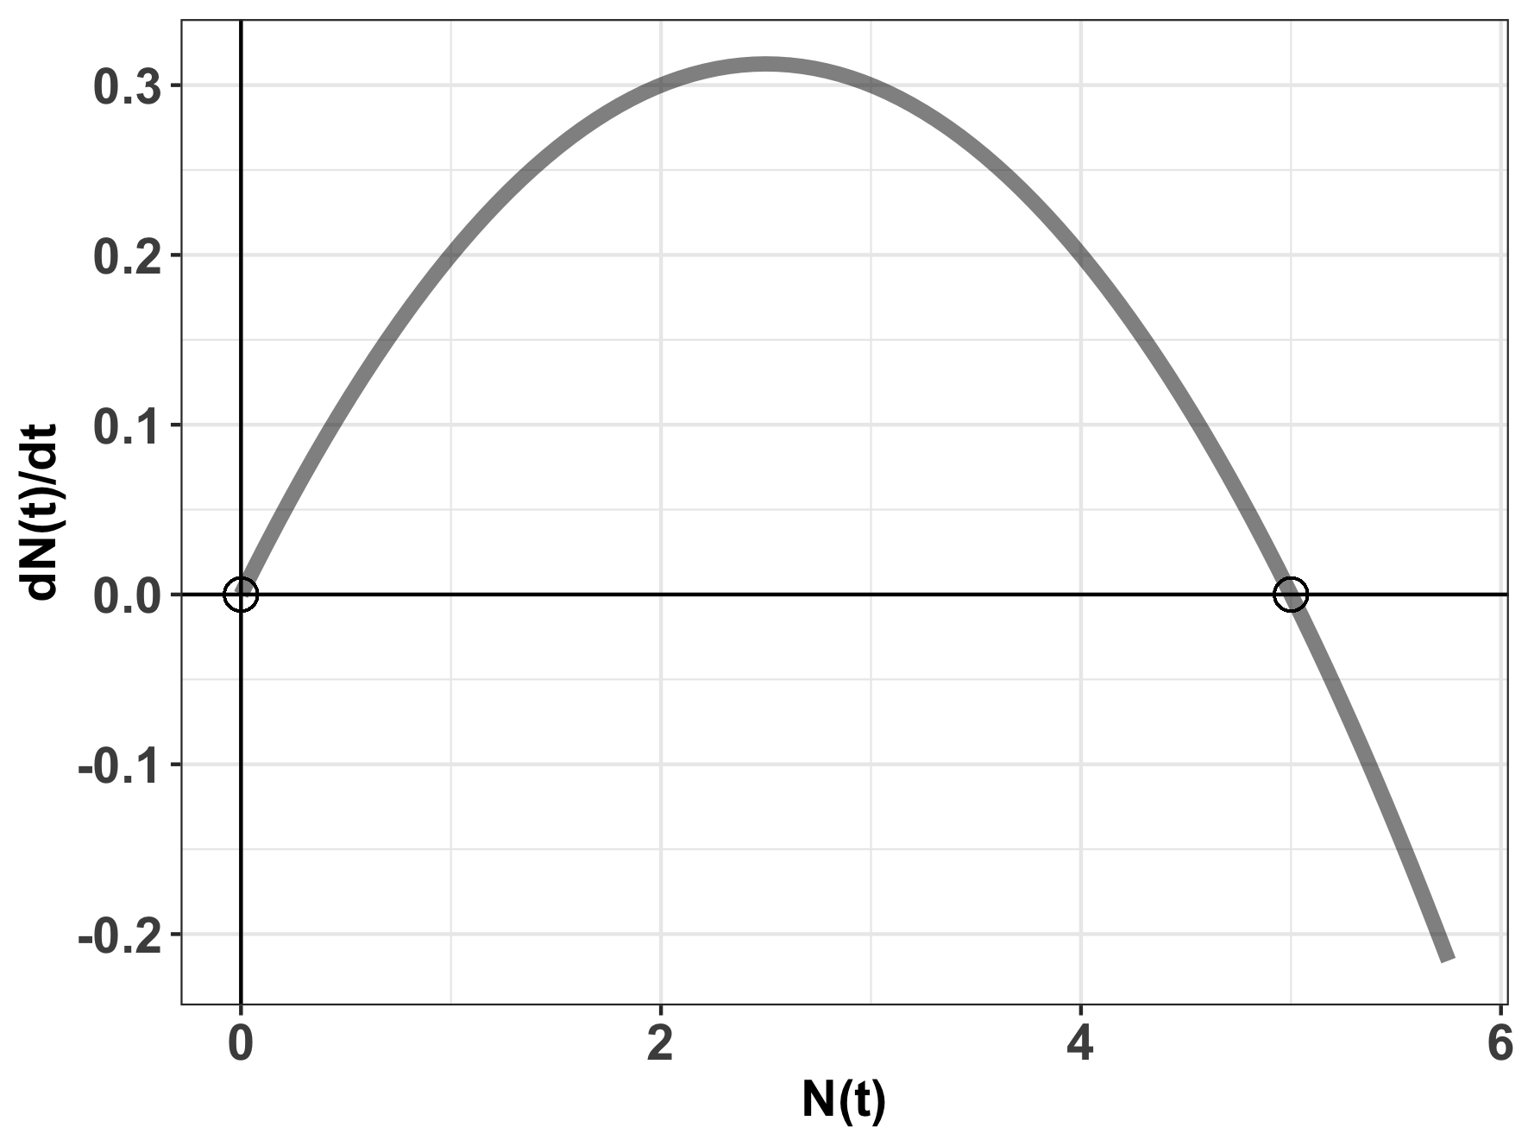


Logistic growth and equilibrium
$$\frac{dN}{dt}=rN\left(1−\frac{N}{K}\right)$$
$$\frac{dN}{dt}=0$$
$$0=rN\left(1−\frac{N}{K}\right)$$
$$N=K or$$
logistic growth equilibria
$$N=0$$

Slide 27
Logistic growth and equilibrium
$$\frac{dN}{dt}=rN\left(1−\frac{N}{K}\right)$$
$$\frac{dN}{dt}=0$$
$$0=rN\left(1−\frac{N}{K}\right)$$
$$N=K or$$
logistic growth equilibria
$$N=0$$
What is K?

Slide 28

Logistic growth and equilibrium
$$\frac{dN}{dt}=rN\left(1−\frac{N}{K}\right)$$
$$\frac{dN}{dt}=0$$
$$K=5$$
$$0=rN\left(1−\frac{N}{K}\right)$$
$$N=K or$$
logistic growth equilibria
$$N=0$$
What is K?

Slide 29

Logistic growth and equilibrium
$$\frac{dN}{dt}=rN\left(1−\frac{N}{K}\right)$$
$$\frac{dN}{dt}=0$$
$$K=5$$
$$0=rN\left(1−\frac{N}{K}\right)$$
$$N=K or$$
logistic growth equilibria
$$N=0$$
Stability: If the population is perturbed, will it return to equilibrium?

Slide 30
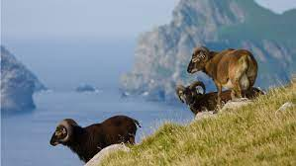
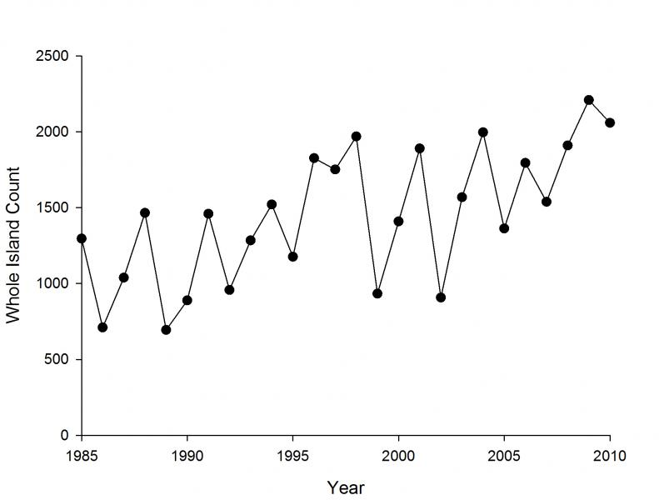
Many populations will fluctuate above or below carrying capacity.
Soay Sheep of St. Kilda, Scotland

Slide 31
Many populations will fluctuate above or below carrying capacity.
But they can still be stable populations if they return to equilibrium.
Soay Sheep of St. Kilda, Scotland
Notes:
We’ll talk about what happens when you

Slide 32
Many populations will fluctuate above or below carrying capacity.
But they can still be stable populations if they return to equilibrium.
Soay Sheep of St. Kilda, Scotland
In some cases, it is not possible to recover.

Slide 33
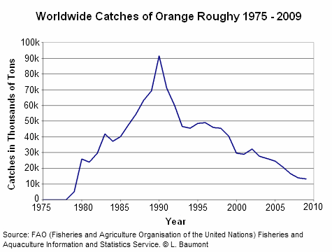
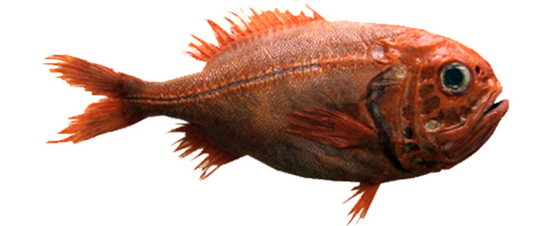
Many populations will fluctuate above or below carrying capacity.
But they can still be stable populations if they return to equilibrium.
In some cases, it is not possible to recover.
Notes:
Orange roughy = overexploited fishery in mostly southern hemisphere. Large, very long-lived fish. Biggest fishery in NZ but also important in Australia

Slide 34
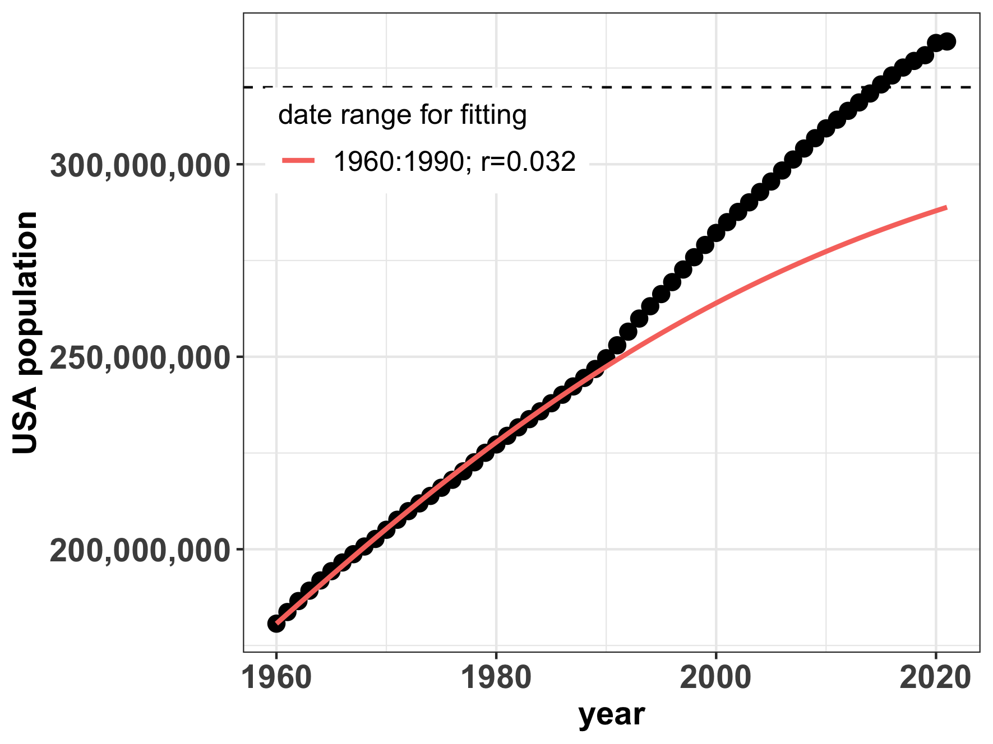
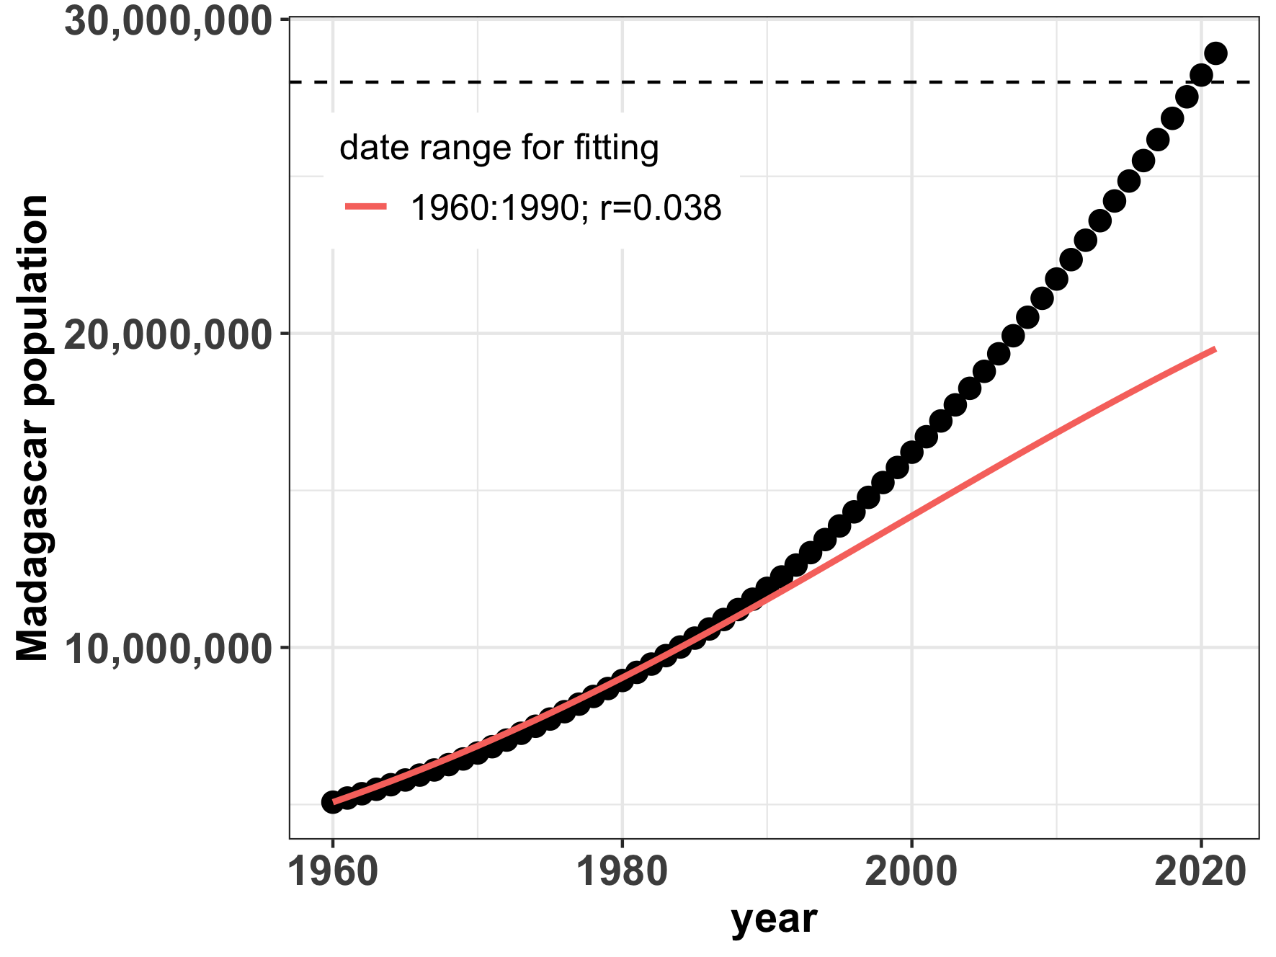
Logistic growth still does not describe human populations well.
K=302,000,000
K=28,000,000
Notes:
We are exceeding carrying capacity as might have been projected in 1990… Maybe the US is starting to move towards an S curve but Madagascar definitely not
The question is whether we overshoot our own K, as Malthus predicted - or not!

Slide 35
Logistic growth and equilibrium
$$\frac{dN}{dt}=rN\left(1−\frac{N}{K}\right)$$
$$\frac{dN}{dt}=0$$
When population size is not changing, the population is said to be at equilibrium.
Mathematically, the carrying capacity (K) can be shown to be a stable equilibrium, meaning that if the system is perturbed, it will return to this point.
Notes:
Logistic growth suggests that there are density-dependent growth rates and that carrying capacity is a stable equilibrium in the dynamical system.
When an This means that

Slide 36
Logistic growth and equilibrium
$$\frac{dN}{dt}=rN\left(1−\frac{N}{K}\right)$$
$$\frac{dN}{dt}=0$$
$$K=5$$
When population size is not changing, the population is said to be at equilibrium.
Mathematically, the carrying capacity (K) can be shown to be a stable equilibrium, meaning that if the system is perturbed, growth will accelerate or decelerate to return the population to K.
Notes:
N= K is a stable equilibrium. Small negative perturbations to the system will result in r > 0 which will grow to N=K. Small negative perturbations to the system will result in r <0 and sink to N=K
N= 0 is an unstable equilibrium. Small perturbations to the system around N=0 will result in r > 0 which will grow to N = K.

Slide 37
Logistic growth and harvesting
Humans have attempted to leverage density-dependent growth rates for sustainable harvesting, which refers to the offtake of individuals within a population’s capacity for replenishment. Frequently, this refers to the harvesting of animals for human consumption.
Notes:
Now that we understand density-dependent growth, we’ll explore how humans have attempted to leverage this stability

Slide 38
Logistic growth and harvesting
Humans have attempted to leverage density-dependent growth rates for sustainable harvesting, which refers to the offtake of individuals within a population’s capacity for replenishment. Frequently, this refers to the harvesting of animals for human consumption.
The science of sustainable harvest is used extensively in fisheries management.
Notes:
Now that we understand density-dependent growth, we’ll explore how humans have attempted to leverage this stability

Slide 39
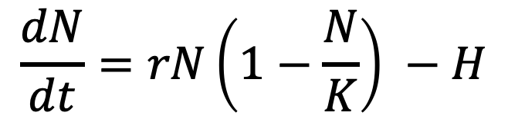
Logistic growth and harvesting
Humans have attempted to leverage density-dependent growth rates for sustainable harvesting, which refers to the offtake of individuals within a population’s capacity for replenishment. Frequently, this refers to the harvesting of animals for human consumption.
The science of sustainable harvest is used extensively in fisheries management.
population size
change in population size with time
$$\frac{dN}{dt}=rN\left(1−\frac{N}{K}\right) −H$$
harvesting rate
carrying capacity
intrinsic growth rate
density-dependence
Notes:
Now that we understand density-dependent growth, we’ll explore how humans have attempted to leverage this stability

Slide 40
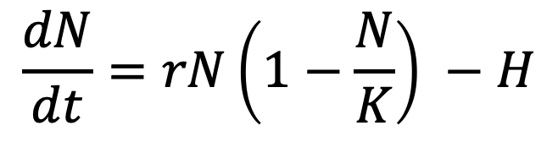
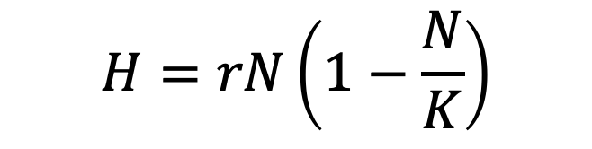
Logistic growth and harvesting
$$\frac{dN}{dt}=rN\left(1−\frac{N}{K}\right) −H$$
For a harvested population, theoretically, the population size is at equilibrium if the harvest rate equals the growth rate.
$$H=rN\left(1−\frac{N}{K}\right)$$

Slide 41
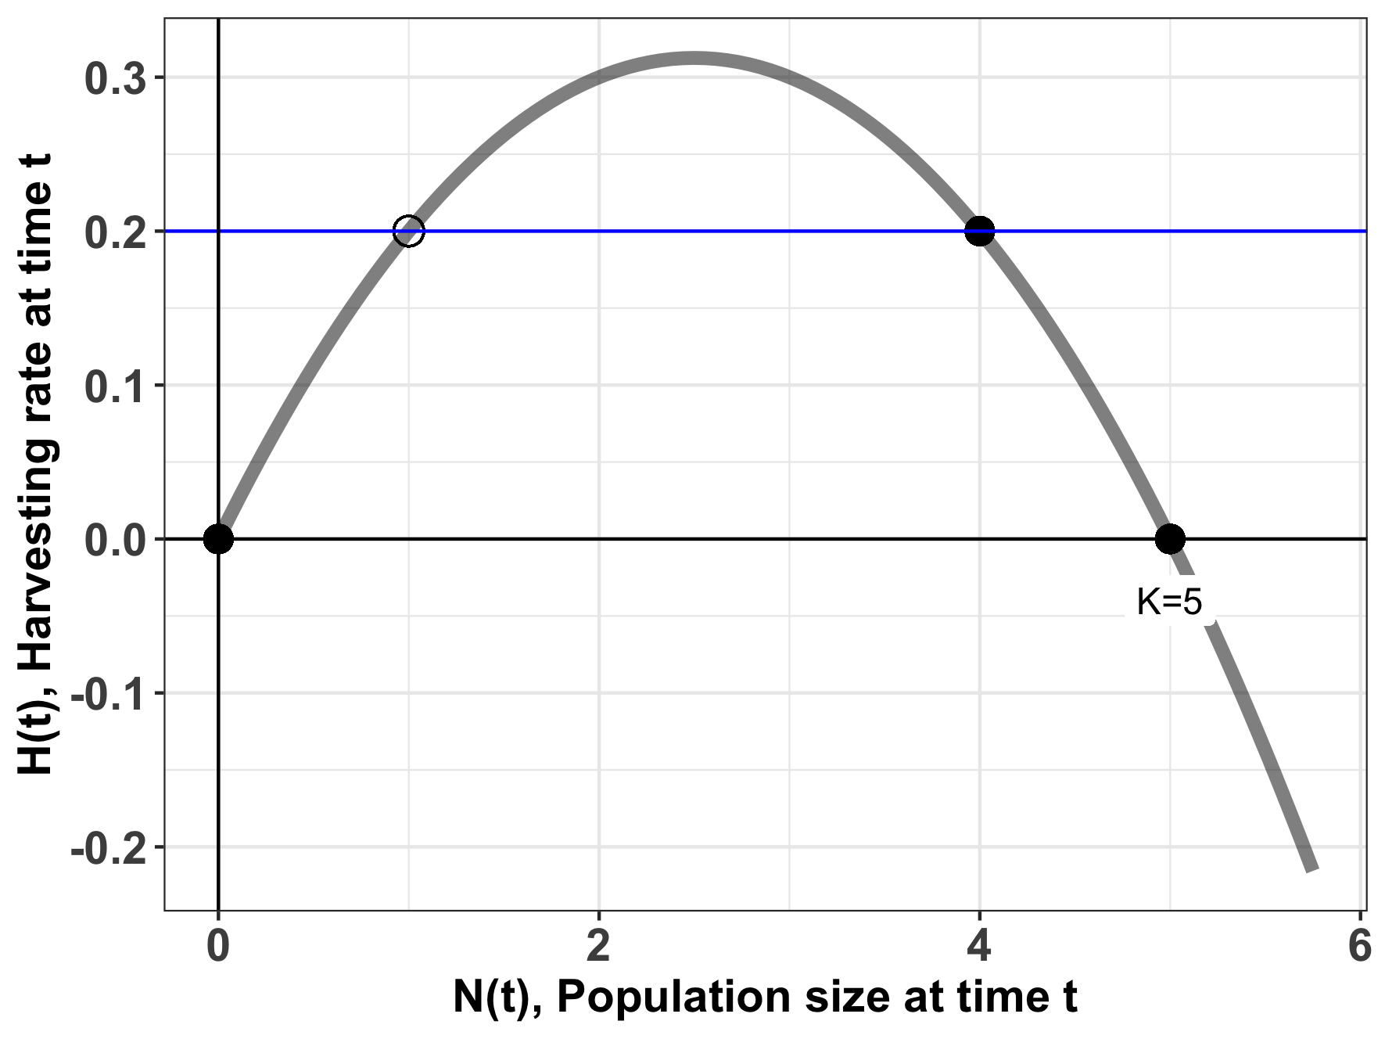
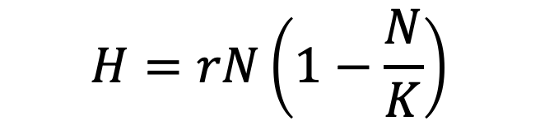
The stability of harvesting depends on population size.
$$H=rN\left(1−\frac{N}{K}\right)$$
harvesting rate
carrying capacity

Slide 42
The stability of harvesting depends on population size.
$$H=rN\left(1−\frac{N}{K}\right)$$
stable equilibrium
For a population of N=4, a harvest rate of 0.2 (animals/timestep) results in a stable equilibrium (sustainable harvest).
Notes:
N=4 is a stable equilibrium. Small negative perturbations to the system will result in r > 0 which will grow to N=4. Small negative perturbations to the system will result in r <0 and sink to N=4.
You can test this just by filling in values. This curve was built assuming r = 0.25 and K= 5. Try it testing N=2 (dN/dt eqn is positive) or N=6 (dN/dt eqn is negative)

Slide 43
The stability of harvesting depends on population size.
$$H=rN\left(1−\frac{N}{K}\right)$$
stable equilibrium
For a population of N=4, a harvest rate of 0.2 (animals/timestep) results in a stable equilibrium (sustainable harvest).
Increases or decreases in population size will be compensated to return the system to N=4.
Notes:
You can test this just by filling in values. This curve was built assuming r = 0.25 and K= 5. Try it testing N=2 (dN/dt eqn is positive) or N=6 (dN/dt eqn is negative)

Slide 44
The stability of harvesting depends on population size.
$$H=rN\left(1−\frac{N}{K}\right)$$
unstable equilibrium
For a population of N=1, a harvest rate of 0.2 (animals/timestep) results in an unsustainable equilibrium.
Notes:
N= 1 is an unstable equilibrium.
Small negative perturbations to the system around N=2 will sink to N=0.
Small positive perturbations to the system around N=2 will will grow to N=4.
You can test this just by filling in values. This curve was built assuming r = 0.25 and K= 5. Try it testing N=2 (dN/dt eqn is positive) or N=.5 (dN/dt eqn is negative)

Slide 45
The stability of harvesting depends on population size.
$$H=rN\left(1−\frac{N}{K}\right)$$
unstable equilibrium
For a population of N=1, a harvest rate of 0.2 (animals/timestep) results in an unsustainable equilibrium.
Random increases or decreases in population size will result in the population moving away from N=1 to, respectively, N=4 or N=0 (the latter is a population collapse).
Notes:
𝐌2−4𝐇𝐌𝐤 > 0 ⇒ 𝐇<𝐤𝐌4 − �2−4��� > 0 ⇒ �<��4 − ("subcritical harvesting"): we have two equilibrium solutions smaller than 𝑀 � , the "carrying capacity" in the standard logistic model, that we could call 𝑀+ �+ and 𝑀− �− ; the differential equation becomes 𝑑𝑃𝑑𝑡 = −𝑘𝑀·(𝑃−𝑀+)·(𝑃−𝑀−) ,���� = −��·(�−�+)·(�−�−) , which is separable and can be solved by using partial-fraction decomposition; we in turn have three cases for the initial condition, 𝑃0<𝑀− , 𝑀−<𝑃0<𝑀+ , �0<�− , �−<�0<�+ , and 𝑃0>𝑀+ ; �0>�+ ; we find that 𝑀+ �+ is the "attractor" (stable) equilibrium solution and 𝑀− �− is the "repeller" (unstable) equilibrium
N= 1 is an unstable equilibrium.
Small negative perturbations to the system around N=2 will sink to N=0.
Small positive perturbations to the system around N=2 will will grow to N=4.
You can test this just by filling in values. This curve was built assuming r = 0.25 and K= 5. Try it testing N=2 (dN/dt eqn is positive) or N=.5 (dN/dt eqn is negative)

Slide 46
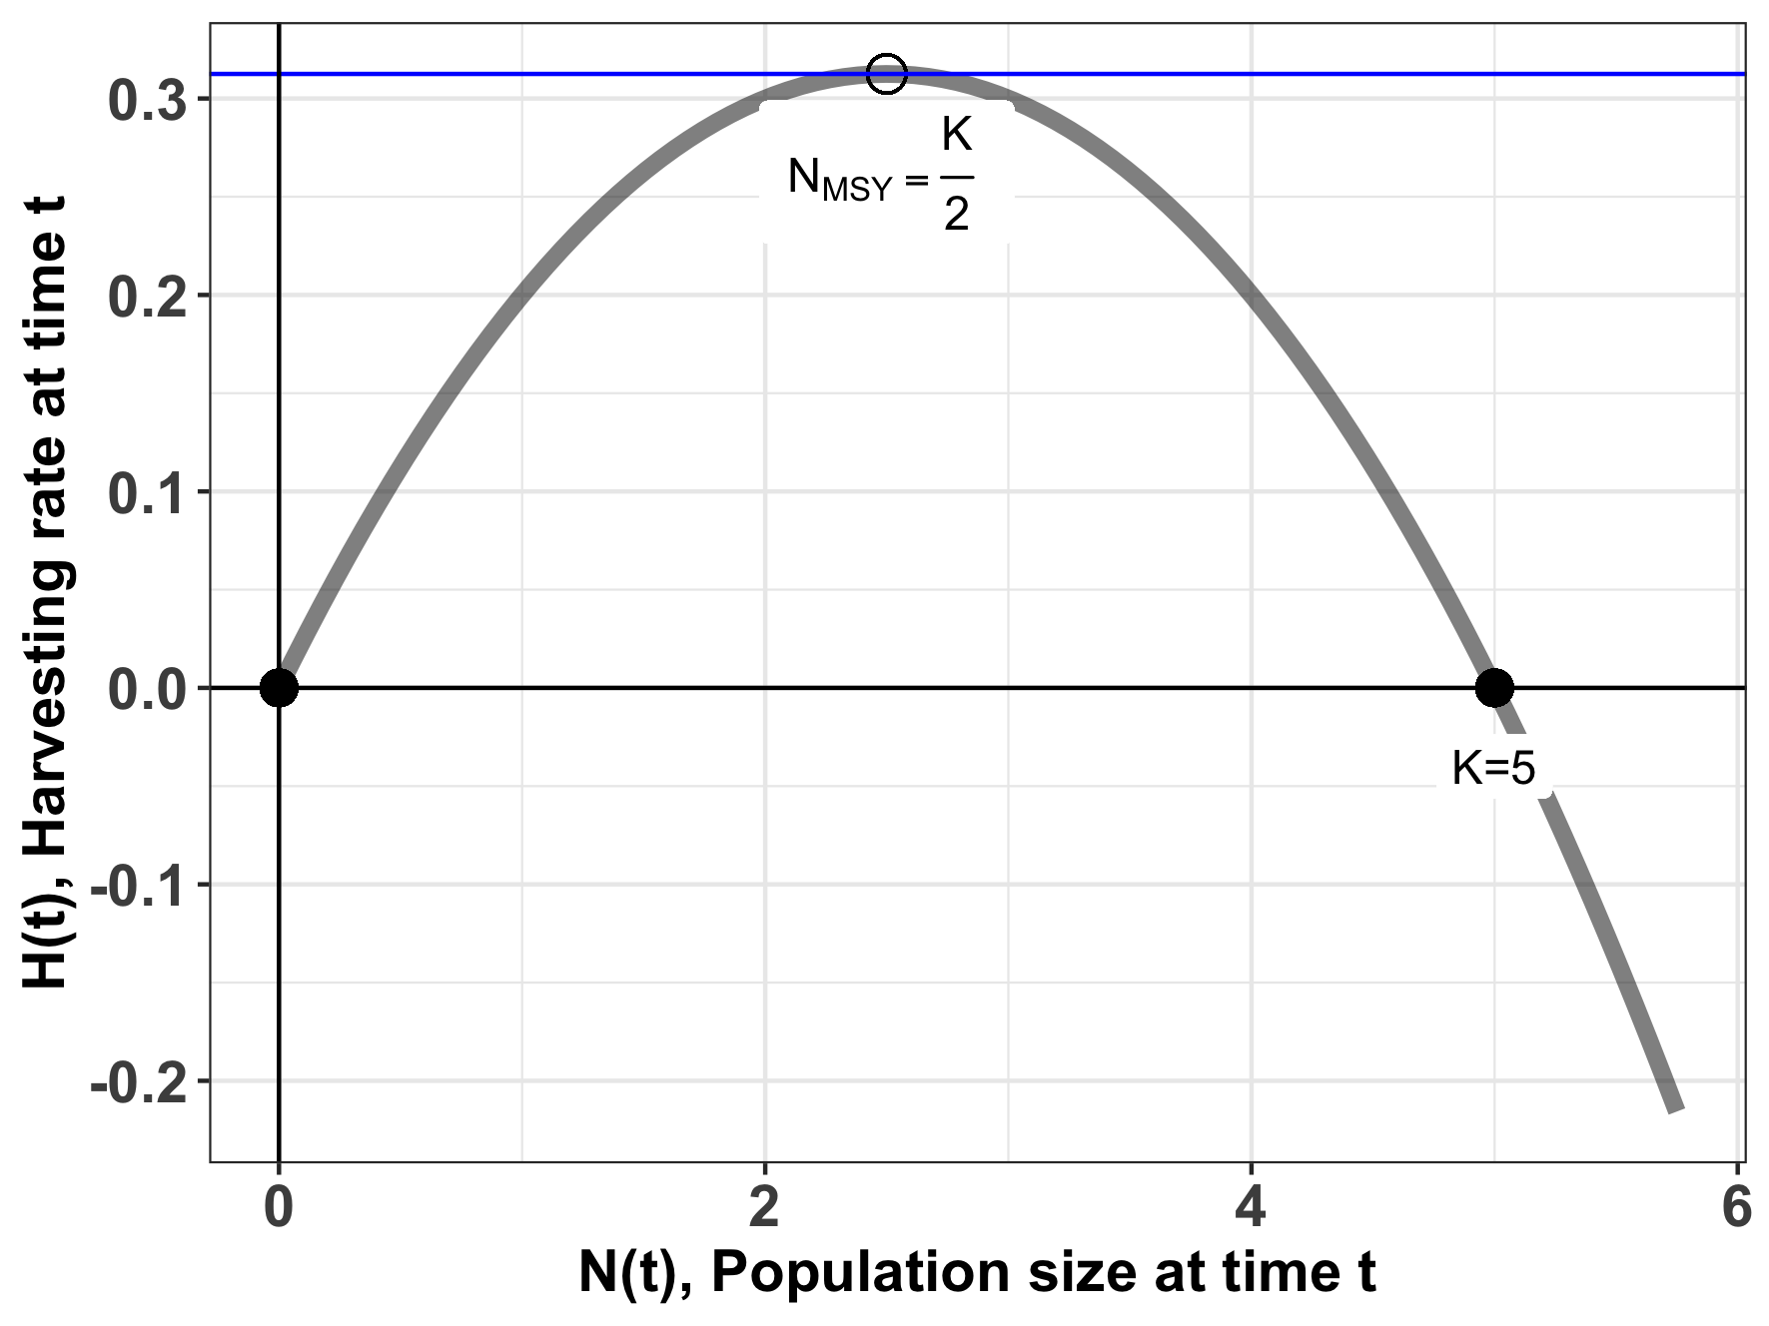
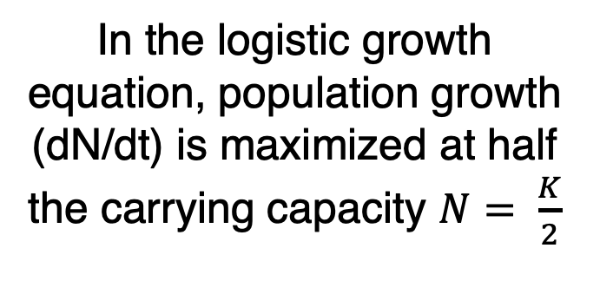
Maximum sustainable yield (MSY)
$$H=rN\left(1−\frac{N}{K}\right)$$
In the logistic growth equation, population growth (dN/dt) is maximized at half the carrying capacity $N= \frac{K}{2}$
Notes:
You can test this by filling in values of N on either side of N=2.5 (try N=3 and N=2) for harvesting = 0.25*5/4 = 0.312

Slide 47
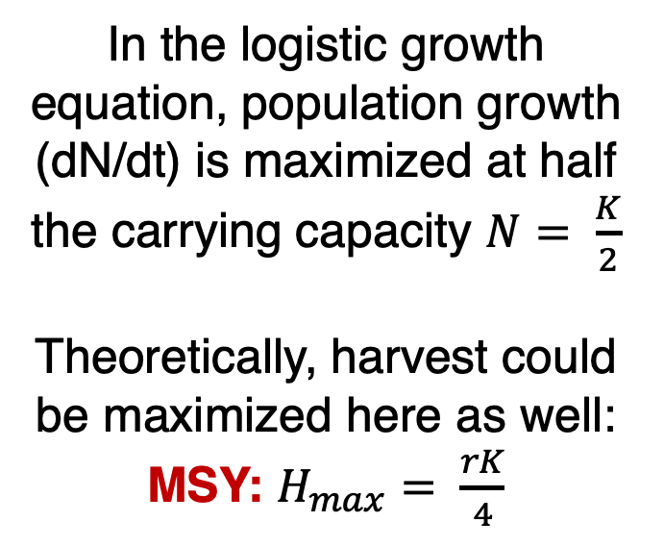
Maximum sustainable yield (MSY)
$$H=rN\left(1−\frac{N}{K}\right)$$
In the logistic growth equation, population growth (dN/dt) is maximized at half the carrying capacity $N= \frac{K}{2}$
Theoretically, harvest could be maximized here as well:
MSY: $H_{max}= \frac{rK}{4}$
take the derivative with respect to N

Slide 48

Maximum sustainable yield (MSY)
$$H=rN\left(1−\frac{N}{K}\right)$$
MSY: $H_{max}= \frac{rK}{4}$
The MSY is a semi-stable equilibrium, meaning that small gains in population size (N) will be compensated to return the system to N_{MSY,} while small losses will result in the system collapsing to N=0.

Slide 49
Case Study: Orange Roughy
Found in deep waters of eastern Pacific (Chile), western Pacific (Australia/NZ), and southeastern Atlantic (Namibia to South Africa)
Can live up to 200 years! Matures at 20-30 yrs
Fished via trawling, originally thought to have only a 30-year lifespan
Annual global catches began in 1979 and increased to over 90,000 tons in the late 1980s.
High catch levels quickly decreased as stocks were fished down. By the late 1990s, three of the eight NZ orange roughy fisheries had collapsed and were closed.

Slide 50
Case Study: Orange Roughy
Found in deep waters of eastern Pacific (Chile), western Pacific (Australia/NZ), and southeastern Atlantic (Namibia to South Africa)
Can live up to 200 years! Matures at 20-30 yrs
Fished via trawling, originally thought to have only a 30-year lifespan
Annual global catches began in 1979 and increased to over 90,000 tons in the late 1980s.
High catch levels quickly decreased as stocks were fished down. By the late 1990s, three of the eight NZ orange roughy fisheries had collapsed and were closed.

Slide 51
Case Study: Orange Roughy
Found in deep waters of eastern Pacific (Chile), western Pacific (Australia/NZ), and southeastern Atlantic (Namibia to South Africa)
Can live up to 200 years! Matures at 20-30 yrs
Fished via trawling, originally thought to have only a 30-year lifespan
Annual global catches began in 1979 and increased to over 90,000 tons in the late 1980s.
High catch levels quickly decreased as stocks were fished down. By the late 1990s, three of the eight NZ orange roughy fisheries had collapsed and were closed.

Slide 52
Case Study: Orange Roughy
Found in deep waters of eastern Pacific (Chile), western Pacific (Australia/NZ), and southeastern Atlantic (Namibia to South Africa)
Can live up to 200 years! Matures at 20-30 yrs
Fished via trawling, originally thought to have only a 30-year lifespan
Annual global catches began in 1979 and increased to over 90,000 tons in the late 1980s.
High catch levels quickly decreased as stocks were fished down. By the late 1990s, three of the eight NZ orange roughy fisheries had collapsed and were closed.

Slide 53
Case Study: Orange Roughy
Found in deep waters of eastern Pacific (Chile), western Pacific (Australia/NZ), and southeastern Atlantic (Namibia to South Africa)
Can live up to 200 years! Matures at 20-30 yrs
Fished via trawling, originally thought to have only a 30-year lifespan
Annual global catches began in 1979 and increased to over 90,000 tons in the late 1980s.
High catch levels quickly decreased as stocks were fished down. By the late 1990s, three of the eight NZ orange roughy fisheries had collapsed and were closed.

Slide 54
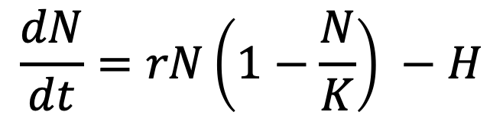
The case of the orange roughy highlights many of the inherent problems with MSY
r and K and N are difficult to measure.
Many harvesting models neglect population structure.
Simple harvesting models assume constant harvest.
MSY fails to acknowledge the reality of overfishing.
Because of the semi-stable equilibrium at MSY, small (natural) decreases in N can be devastating
environmental stochasticity
demographic stochasticity
$$\frac{dN}{dt}=rN\left(1−\frac{N}{K}\right) −H$$

Slide 55
The case of the orange roughy highlights many of the inherent problems with MSY
r and K and N are difficult to measure.
Many harvesting models neglect population structure or model only a single species in isolation.
or model only a single species in isolation.
Simple harvesting models assume constant harvest.
MSY fails to acknowledge the reality of overfishing.
Because of the semi-stable equilibrium at MSY, small (natural) decreases in N can be devastating
environmental stochasticity
demographic stochasticity
$$\frac{dN}{dt}=rN\left(1−\frac{N}{K}\right) −H$$

Slide 56
The case of the orange roughy highlights many of the inherent problems with MSY
r and K and N are difficult to measure.
Many harvesting models neglect population structure or model only a single species in isolation.
Simple harvesting models assume constant harvest.
MSY fails to acknowledge the reality of overfishing.
Because of the semi-stable equilibrium at MSY, small (natural) decreases in N can be devastating
environmental stochasticity
demographic stochasticity
$$\frac{dN}{dt}=rN\left(1−\frac{N}{K}\right) −H$$

Slide 57
The case of the orange roughy highlights many of the inherent problems with MSY
r and K and N are difficult to measure.
Many harvesting models neglect population structure or model only a single species in isolation.
Simple harvesting models assume constant harvest.
MSY fails to acknowledge the reality of overfishing.
Because of the semi-stable equilibrium at MSY, small (natural) decreases in N can be devastating
environmental stochasticity
demographic stochasticity
$$\frac{dN}{dt}=rN\left(1−\frac{N}{K}\right) −H$$

Slide 58
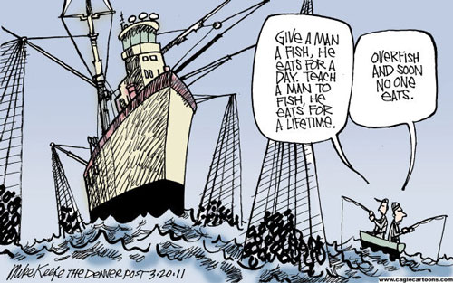
Overfishing: A Tragedy of the Commons
Tragedy of the Commons: A situation in which individual users, who have open access to a common pool resource, cause depletion of the resource through their uncoordinated actions.
Idea was popularized by ecologist Garret Hardin in 1968, a Malthus-like reference to the overpopulation of the Earth
Fisheries provide a classic example of Tragedy of the Commons because property rights are incomplete and access is open.
Many examples of fisheries collapse:
Sturgeon in Caspian sea in 2000s
Atlantic cod in Canada & elsewhere in 1990s
Orange roughy in NZ in 1990s
Despite its dangers, MSY is still highlight as a policy in many international treaties.
Notes:
Garret Hardin = Malthusian, anti-welfare philosophy
Contrast with Elinor Ostrom’s work on successful cooperation for managing land

Slide 59
Overfishing: A Tragedy of the Commons
Tragedy of the Commons: A situation in which individual users, who have open access to a common pool resource, cause depletion of the resource through their uncoordinated actions.
Idea was popularized by ecologist Garret Hardin in 1968, a Malthus-like reference to the overpopulation of the Earth
Fisheries provide a classic example of Tragedy of the Commons because property rights are incomplete and access is open.
Many examples of fisheries collapse:
Sturgeon in Caspian sea in 2000s
Atlantic cod in Canada & elsewhere in 1990s
Orange roughy in NZ in 1990s
Despite its dangers, MSY is still highlight as a policy in many international treaties.
Notes:
Garret Hardin = Malthusian, anti-welfare philosophy
Contrast with Elinor Ostrom’s work on successful cooperation for managing land

Slide 60
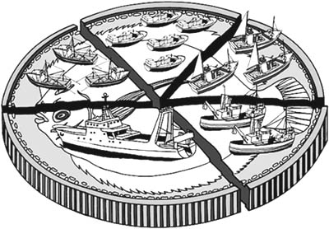
Overfishing: A Tragedy of the Commons
International management of fisheries has been attempted through government coordination to set a Total Allowable Catch (TAC) for each fishery each year.
This practice can lead to intense pressure to fish all at once at the season’s opening, sometimes overshooting the TAC.
This challenge can be mitigated by the use of Individual Fishing Quotas (IFQs) or Individual Transferrable Quotas (ITQs), but allocation is still an issue.
The work of Elinor Ostrom showed that some of these challenges can be overcome when the limits of a resource are clearly defined, when the group of stakeholders is small, and when communication is high.
Notes:
These port-level networks vary in properties such as network resilience (colour of port-location dots: red is lower resilience, green is greater resilience), and they are also comprised of both state and federally managed fisheries (small networks on right: red and blue nodes, respectively).

Slide 61
Overfishing: A Tragedy of the Commons
International management of fisheries has been attempted through government coordination to set a Total Allowable Catch (TAC) for each fishery each year.
This practice can lead to intense pressure to fish all at once at the season’s opening, sometimes overshooting the TAC.
This challenge can be mitigated by the use of Individual Fishing Quotas (IFQs) or Individual Transferrable Quotas (ITQs), but allocation is still an issue.
The work of Elinor Ostrom showed that some of these challenges can be overcome when the limits of a resource are clearly defined, when the group of stakeholders is small, and when communication is high.
Notes:
These port-level networks vary in properties such as network resilience (colour of port-location dots: red is lower resilience, green is greater resilience), and they are also comprised of both state and federally managed fisheries (small networks on right: red and blue nodes, respectively).

Slide 62
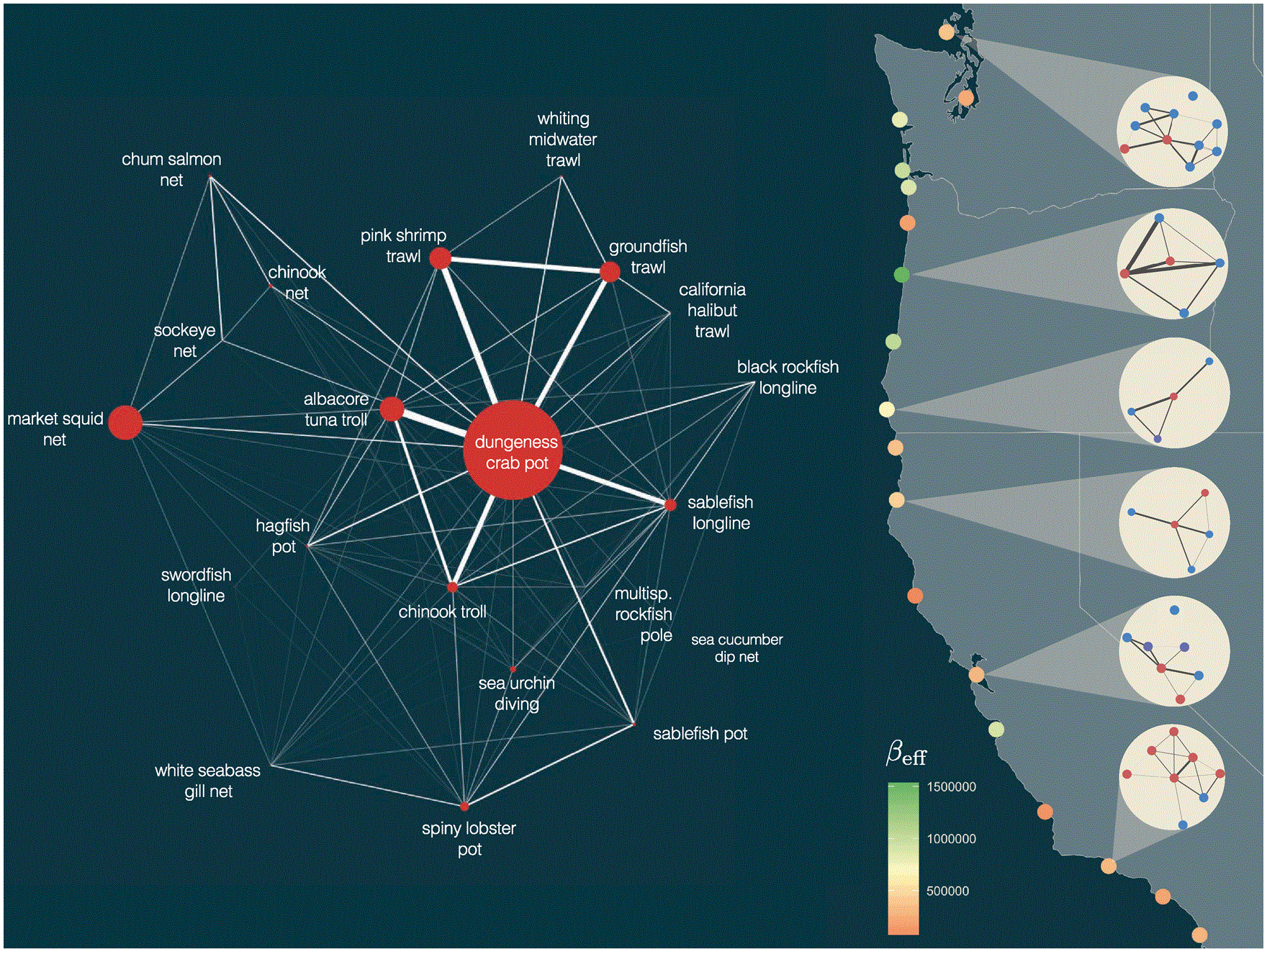
Overfishing: A Tragedy of the Commons
International management of fisheries has been attempted through government coordination to set a Total Allowable Catch (TAC) for each fishery each year.
This practice can lead to intense pressure to fish all at once at the season’s opening, sometimes overshooting the TAC.
This challenge can be mitigated by the use of Individual Fishing Quotas (IFQs) or Individual Transferrable Quotas (ITQs), but allocation is still an issue.
The work of Elinor Ostrom showed that some of these challenges can be overcome when the limits of a resource are clearly defined, when the group of stakeholders is small, and when communication is high.
Dr. Emma Fuller, Fractal Agriculture
Fuller et al. 2017. ICES Journal of Marine Science
Notes:
These port-level networks vary in properties such as network resilience (colour of port-location dots: red is lower resilience, green is greater resilience), and they are also comprised of both state and federally managed fisheries (small networks on right: red and blue nodes, respectively).

Slide 63
The case of the orange roughy highlights many of the inherent problems with MSY
r and K and N are difficult to measure.
Many harvesting models neglect population structure or model only a single species in isolation.
Simple harvesting models assume constant harvest.
MSY fails to acknowledge the reality of overfishing.
Because of the semi-stable equilibrium at MSY, small (natural) decreases in N can be devastating
environmental stochasticity
demographic stochasticity
$$\frac{dN}{dt}=rN\left(1−\frac{N}{K}\right) −H$$

Slide 64
Deterministic vs. Stochastic

Slide 65

Deterministic vs. Stochastic
if deterministic
“always the same”
annual survival rate = 0.5

Slide 66
Deterministic vs. Stochastic
if deterministic
“always the same”
annual survival rate = 0.5

Slide 67
Deterministic vs. Stochastic
if deterministic
“always the same”
annual survival rate = 0.5
All the models we have looked at so far have been deterministic!

Slide 68
Deterministic vs. Stochastic
if deterministic
“always the same”
annual survival rate = 0.5
if stochastic
“up to chance”
annual survival rate = 0.5

Slide 69
Deterministic vs. Stochastic
if deterministic
“always the same”
annual survival rate = 0.5
if stochastic
“up to chance”
annual survival rate = 0.5

Slide 70
Deterministic vs. Stochastic
if deterministic
“always the same”
annual survival rate = 0.5
if stochastic
“up to chance”
annual survival rate = 0.5

Slide 71
The case of the orange roughy highlights many of the inherent problems with MSY
r and K and N = difficult to measure.
Neglect population structure.
Single species models.
Assumes constant harvest.
Ignores reality of overfishing.
Because of the semi-stable equilibrium at MSY, small (natural) decreases in N can be devastating
environmental stochasticity
temporal changes in mortality or reproductive rate (e.g. due to climate)
if stochastic
“up to chance”
annual survival rate = 0.5
cyclone year!
Notes:
Demographic stochasticity describes the within-individual variability (growth rate might vary from one individual to the next)
while environmental stochasticity refers to temporary environmental fluctuations that lead to changes in population growth rates (climate change and egg survival)

Slide 72
The case of the orange roughy highlights many of the inherent problems with MSY
r and K and N = difficult to measure.
Neglect population structure.
Single species models.
Assumes constant harvest.
Ignores reality of overfishing.
Because of the semi-stable equilibrium at MSY, small (natural) decreases in N can be devastating
environmental stochasticity
temporal changes in mortality or reproductive rate (due to climate)
demographic stochasticity
individual-level differences in mortality and reproduction, esp. at small pop size
if deterministic
“always the same”
annual fecundity = 0.5
Notes:
Demographic stochasticity describes the within-individual variability (growth rate might vary from one individual to the next)
while environmental stochasticity refers to temporary environmental fluctuations that lead to changes in population growth rates (climate change and egg survival)

Slide 73


The case of the orange roughy highlights many of the inherent problems with MSY
r and K and N = difficult to measure.
Neglect population structure.
Single species models.
Assumes constant harvest.
Ignores reality of overfishing.
Because of the semi-stable equilibrium at MSY, small (natural) decreases in N can be devastating
environmental stochasticity
temporal changes in mortality or reproductive rate (due to climate)
demographic stochasticity
individual-level differences in mortality and reproduction, esp. at small pop size
if stochastic
“up to chance”
annual fecundity = 0.5
Only one male encounters only one female, so only 1 new fish is born!
Notes:
Demographic stochasticity describes the within-individual variability (growth rate might vary from one individual to the next)
while environmental stochasticity refers to temporary environmental fluctuations that lead to changes in population growth rates (climate change and egg survival)

Slide 74
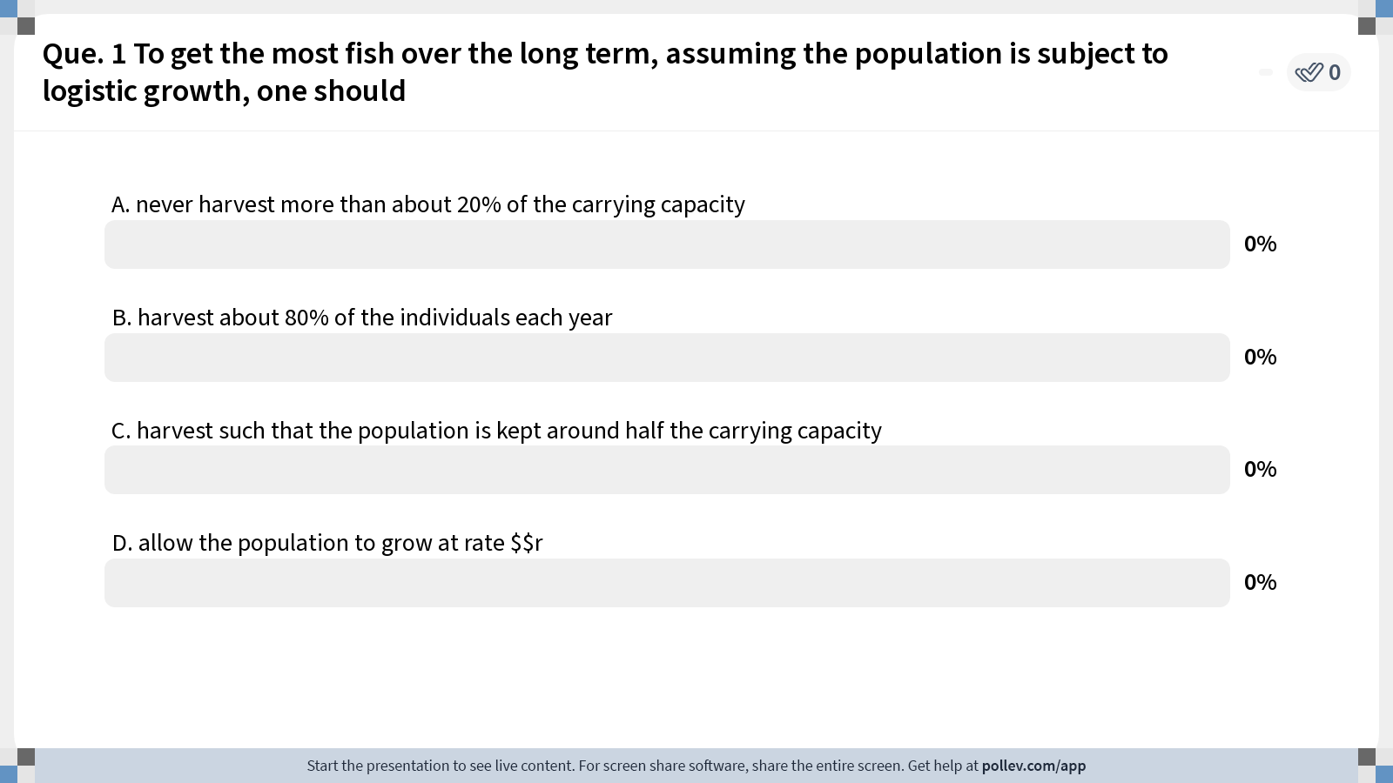
Notes:
Do not modify the notes in this section to avoid tampering with the Poll Everywhere activity. More info at polleverywhere.com/support Que. 1 To get the most fish over the long term, assuming the population is subject to logistic growth, one should
https://www.polleverywhere.com/multiple_choice_polls/1b56JrgFr8EKUhuawVkOR?state=opened&flow=Default&onscreen=persist

Slide 75
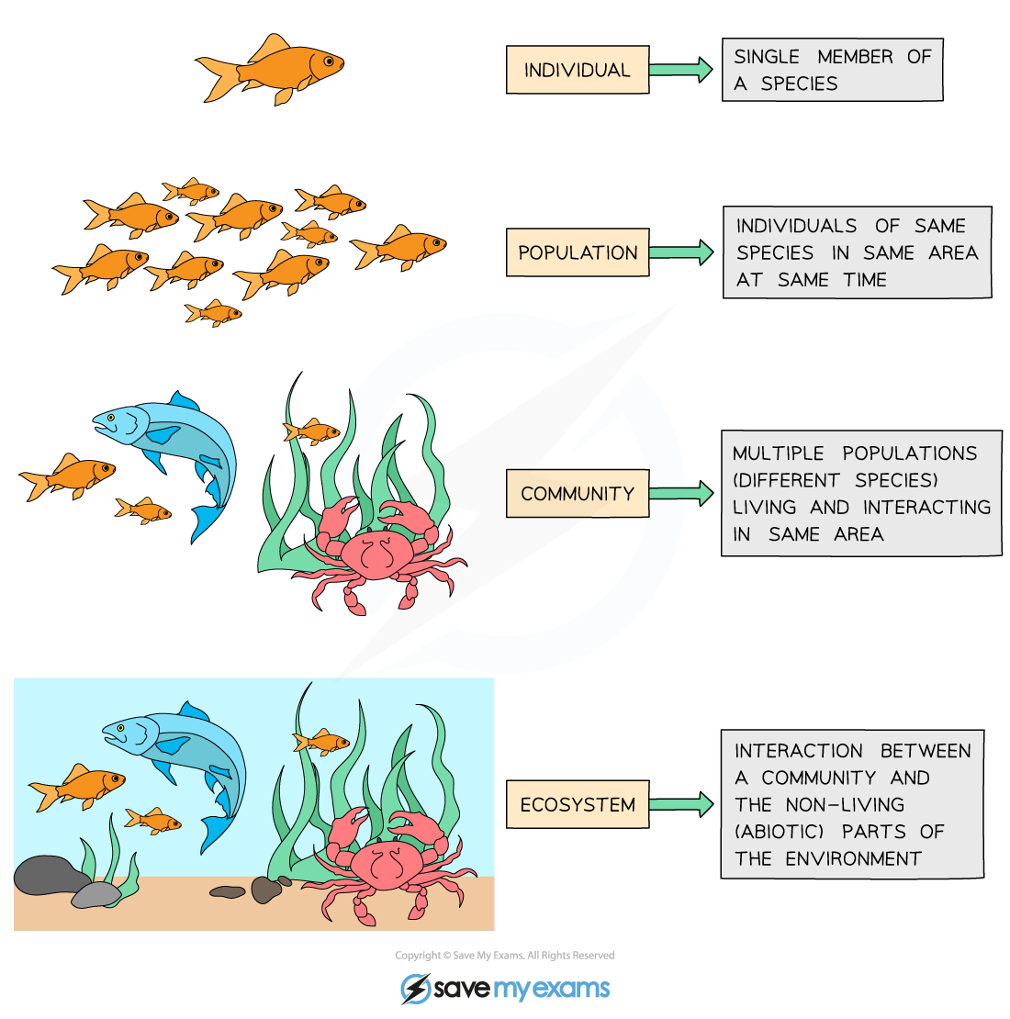
Ecology is the study of the interactions of organisms with each other and their environment.
individual
population
metapopulation
community
ecosystem
Notes:
We explore ecology – using models – across scales

Slide 76
individual
Population = multiple individuals of the same species (conspecifics) in the same habitat
population
metapopulation
fish
(x)
community
How does the abundance of fish change through time?
ecosystem

Slide 77
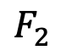
individual
Structured Population = multiple individuals of the same species (conspecifics) in the same habitat but in different life history stages
population
metapopulation
$$F_{2}$$
baby fish (x₁)
adult fish (x₂)
community
1
2
How does the abundance of fish change through time?
ecosystem

Slide 78
Modeling demographic complexity

Slide 79
Modeling demographic complexity
1. Populations are divided into compartments
2. Individuals within a compartment are homogenously mixed
3. Compartments and transition rates are
determined by biological systems
4. Rates of transferring between compartments
are expressed mathematically
births
Madagascar
(N)
deaths
The simplest
population model

Slide 80
Modeling demographic complexity
1. Populations are divided into compartments
2. Individuals within a compartment are homogenously mixed
3. Compartments and transition rates are
determined by biological systems
4. Rates of transferring between compartments
are expressed mathematically
births
Madagascar
(N)
deaths
What is wrong about this model?

Slide 81
Modeling demographic complexity
1. Populations are divided into compartments
2. Individuals within a compartment are homogenously mixed
3. Compartments and transition rates are
determined by biological systems
4. Rates of transferring between compartments
are expressed mathematically
births
Madagascar
(N)
deaths
What is wrong about this model?

Slide 82
Modeling demographic complexity
1. Populations are divided into compartments
2. Individuals within a compartment are homogenously mixed
3. Compartments and transition rates are
determined by biological systems
4. Rates of transferring between compartments
are expressed mathematically
Babies
Adults
The structured
population model

Slide 83
Modeling demographic complexity
1. Populations are divided into compartments
2. Individuals within a compartment are homogenously mixed
3. Compartments and transition rates are
determined by biological systems
4. Rates of transferring between compartments
are expressed mathematically
Babies
Adults
The structured
population model

Slide 84
Modeling demographic complexity
1. Populations are divided into compartments
2. Individuals within a compartment are homogenously mixed
3. Compartments and transition rates are
determined by biological systems
4. Rates of transferring between compartments
are expressed mathematically
births
Babies
aging
Adults
deaths
deaths
The structured
population model

Slide 85
The structured
population model
1. Populations are divided into compartments
2. Individuals within a compartment are homogenously mixed
3. Compartments and transition rates are
determined by biological systems
4. Rates of transferring between compartments
are expressed mathematically
Births (B)
Population rate of increase
Babies
aging (a)
Adults
λ=N_{t+1}/N_{t}
deaths (1-s_{b})
deaths (1-s_{a})
N_{t+1} = A* N_{t}
pop size at t
pop size at t + 1
matrix of survival and fecundity rates
vector of
population sizes
s_{b}(1-a)
B
s_{b}a
s_{a}

Slide 86
The structured
population model
1. Populations are divided into compartments
2. Individuals within a compartment are homogenously mixed
3. Compartments and transition rates are
determined by biological systems
4. Rates of transferring between compartments
are expressed mathematically
Births (B)
Population rate of increase
Babies
aging (a)
Adults
λ=N_{t+1}/N_{t}
deaths (1-s_{b})
deaths (1-s_{a})
N_{t+1} = A* N_{t}
pop size at t
pop size at t + 1
matrix of survival and fecundity rates
vector of
population sizes
s_{b}(1-a)
B
s_{b}a
s_{a}
*Discrete time

Slide 87
The structured
population model
1. Populations are divided into compartments
2. Individuals within a compartment are homogenously mixed
3. Compartments and transition rates are
determined by biological systems
4. Rates of transferring between compartments
are expressed mathematically
Births (B)
Babies
aging (a)
Adults
deaths (1-s_{b})
deaths (1-s_{a})
N_{t+1} = A* N_{t}
A
N_{t}
N_{t+1}
s_{b}(1-a)
B
N_{b}
s_{b}(1-a) N_{b} + BN_{a}
x
=
s_{b}a
s_{a}
N_{a}
s_{b} a N_{b} + s_{a}N_{a}

Slide 88
The structured
population model
1. Populations are divided into compartments
2. Individuals within a compartment are homogenously mixed
3. Compartments and transition rates are
determined by biological systems
4. Rates of transferring between compartments
are expressed mathematically
Births (B)
Babies
aging (a)
Adults
deaths (1-s_{b})
deaths (1-s_{a})
N_{t+1} = A* N_{t}
A
N_{t}
N_{t+1}
Population rate of increase
λ=dominant eigenvalue of transition matrix
s_{b}(1-a)
B
N_{b}
s_{b}(1-a) N_{b} + BN_{a}
x
=
s_{b}a
s_{a}
N_{a}
s_{b} a N_{b} + s_{a}N_{a}
Population growth will depend on population structure!
(pop grows @ λ >1 & declines @ λ < 1 )

Slide 89
Structured populations in practice
Soay Sheep of St. Kilda, Scotland
Notes:
Since the 1980s, scientists from Cambridge have been censusing them annually and tagging every individual. They exhibit these dramatic population fluctuations

Slide 90
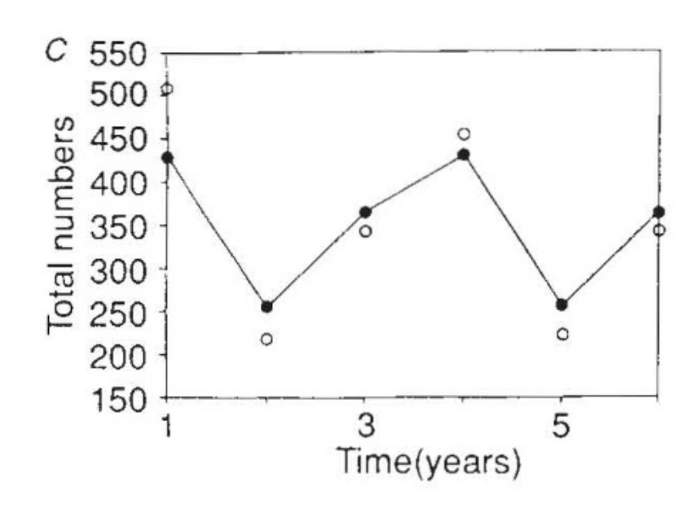
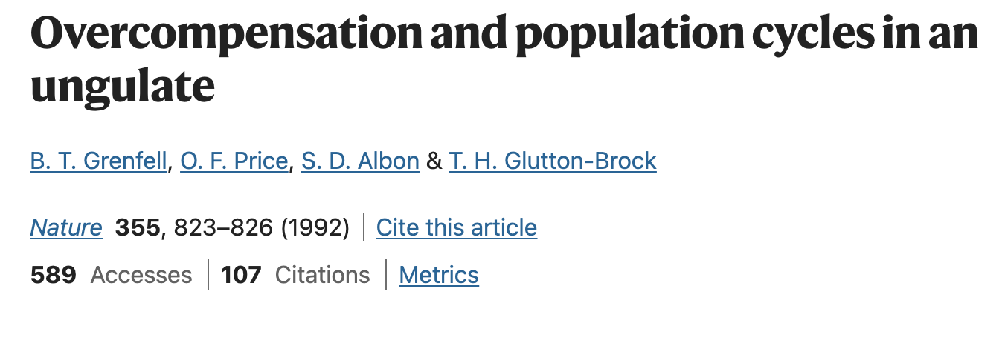
Structured populations in practice
Model compared against data
Soay Sheep of St. Kilda, Scotland
Notes:
Models used both to predict and to explain

Slide 91
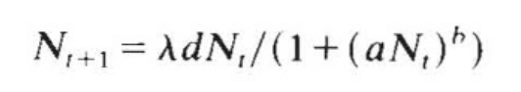
Structured populations in practice
Model compared against data
These results used a simple density-dependent model only!
a and b control the strength of density dependence.
growth rate
population at t+1
average fecundity
population at t
Notes:
Models used both to predict and to explain

Slide 92
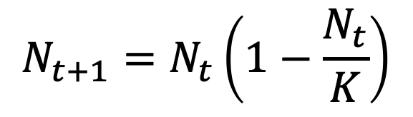
Structured populations in practice
Model compared against data
These results used a simple density-dependent model only!
a and b control the strength of density dependence.
growth rate
population at t+1
average fecundity
population at t
Similar to the simple logistic growth equation!
$$N_{t+1}=N_{t}\left(1−\frac{N_{t}}{K}\right)$$
Notes:
Models used both to predict and to explain

Slide 93
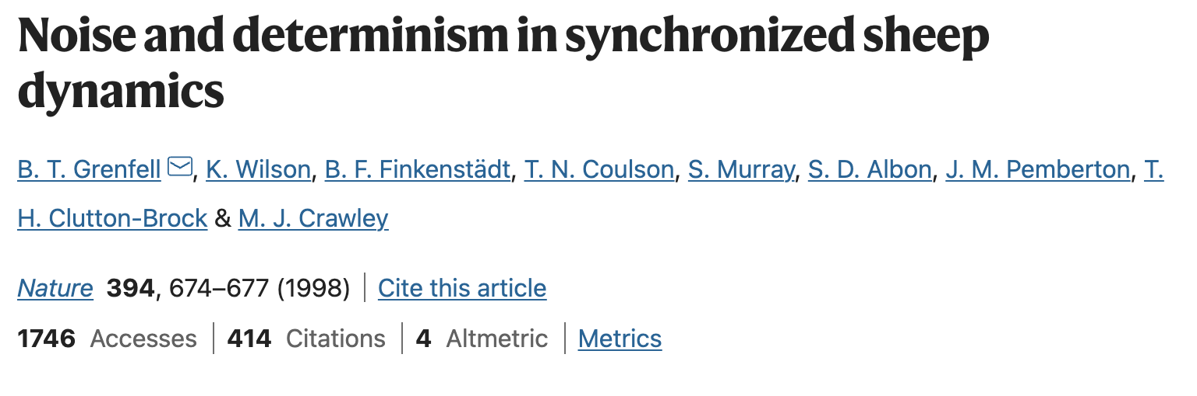
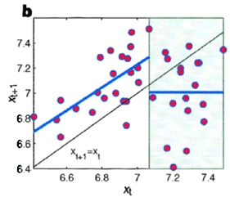
Structured populations in practice
In later work, the authors added environmental stochasticity (bad weather) to better represent the data……
Notes:
Models used both to predict and to explain

Slide 94
Structured populations in practice
In later work, the authors added environmental stochasticity (bad weather) to better represent the data……
Notes:
Models used both to predict and to explain

Slide 95
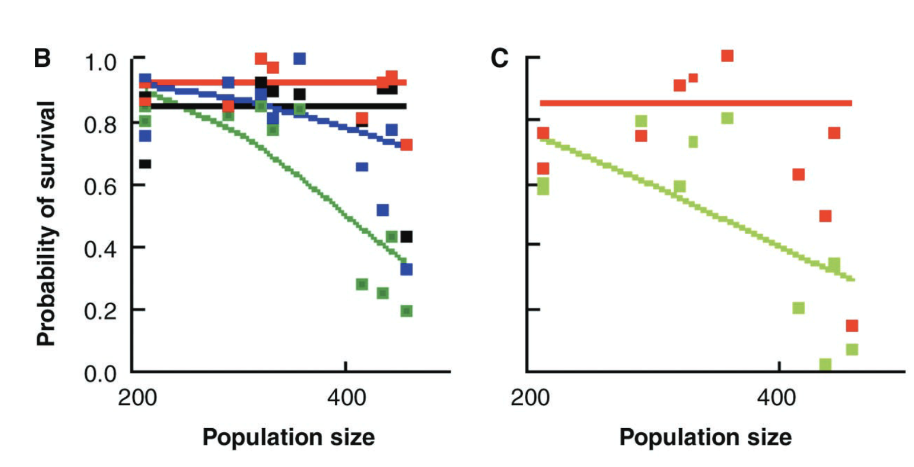
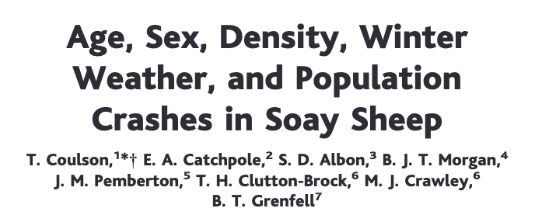

Structured populations in practice
And, finally, they added in population structure as well!
lambs
yearlings
adults
older adults
lambs
adults
Notes:
Colors

Slide 96
The structured
population model
If data are available, we can model much more detailed population structures using the same approach.
F₃
F₄
F₅
F₂
Age₁
Age₂
Age₃
Age₄
Age₅
s₁
s₂
s₃
s₄
The Leslie matrix model divides classes based on age.
The Lefkovitch matrix model divides classes based on life stage.
Leslie 1945 Biometrika. Leslie 1948 Biometrika.
Lefkovitch 1965 Biometrics.

Slide 97
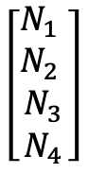
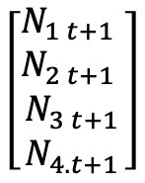
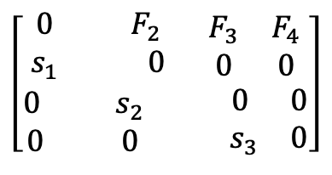
The structured
population model
If data are available, we can model much more detailed population structures using the same approach.
F₃
F₄
F₂
Age₁
Age₂
Age₃
Age₄
s₁
s₂
s₃
A
N_{t}
N_{t+1}
λ=dominant eigenvalue of transition matrix
$$\left[\begin{aligned}\begin{matrix}0 & F_{2} \\ s_{1} & 0\end{matrix} \begin{matrix}F_{3} & F_{4} \\ 0 & 0\end{matrix} \\ \begin{matrix}0 & s_{2} \\ 0 & 0\end{matrix} \begin{matrix} 0 & 0 \\ .{ s}_{3} & 0\end{matrix}\end{aligned}\right]$$
$$\left[\begin{matrix}\begin{matrix}N_{1} \\ N_{2}\end{matrix} \\ \begin{matrix}N_{3} \\ N_{4}\end{matrix}\end{matrix}\right]$$
$$\left[\begin{matrix}\begin{matrix}N_{1 t+1} \\ N_{2 t+1}\end{matrix} \\ \begin{matrix}N_{3 t+1} \\ N_{4.t+1}\end{matrix}\end{matrix}\right]$$
x
=
N_{t+1} = A* N_{t}
Leslie 1945 Biometrika. Leslie 1948 Biometrika.
Lefkovitch 1965 Biometrics.

Slide 98
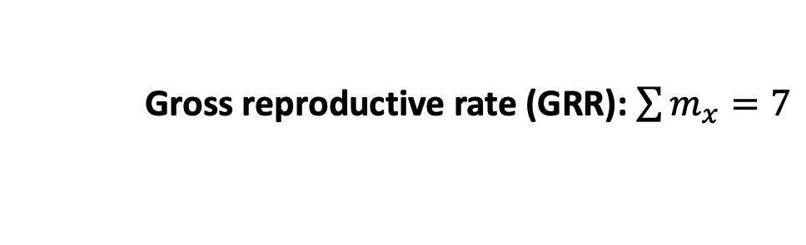
The structured
population model
F₃
F₄
F₂
Age₁
Age₂
Age₃
Age₄
Demographers collect these rates in life tables
s₁
s₂
s₃
x (age) | N_{x} (number in cohort) | l_{x} (survivorship to age x) | m_{x} (fecundity) | l_{x}m_{x}
0 | 100 | 1 | 0 | 0
1 | 60 | .6 | 2 | 1.2
2 | 30 | .3 | 3 | 0.9
3 | 10 | .1 | 1 | 0.1
4 | 1 | .01 | 1 | 0.01
x
=
Gross reproductive rate (GRR): $\sum{m_{x}=7}$

Slide 99
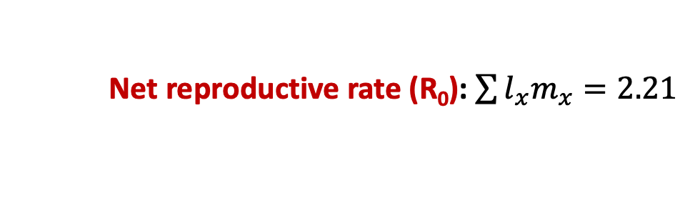
The structured
population model
F₃
F₄
F₂
Age₁
Age₂
Age₃
Age₄
Demographers collect these rates in life tables
s₁
s₂
s₃
x (age) | N_{x} (number in cohort) | l_{x} (survivorship to age x) | m_{x} (fecundity) | l_{x}m_{x}
0 | 100 | 1 | 0 | 0
1 | 60 | .6 | 2 | 1.2
2 | 30 | .3 | 3 | 0.9
3 | 10 | .1 | 1 | 0.1
4 | 1 | .01 | 1 | 0.01
x
=
Net reproductive rate (R₀): $\sum{l_{x}m_{x}=2.21}$

Slide 100
The structured
population model
F₃
F₄
F₂
Age₁
Age₂
Age₃
Age₄
Demographers collect these rates in life tables
s₁
s₂
s₃
x (age) | N_{x} (number in cohort) | l_{x} (survivorship to age x) | m_{x} (fecundity) | l_{x}m_{x}
0 | 100 | 1 | 0 | 0
1 | 60 | .6 | 2 | 1.2
2 | 30 | .3 | 3 | 0.9
3 | 10 | .1 | 1 | 0.1
4 | 1 | .01 | 1 | 0.01
x
=
Net reproductive rate (R₀): $\sum{l_{x}m_{x}=2.21}$
(pop grows at $R0$ >1 and declines at $R0$ < 1)

Slide 101
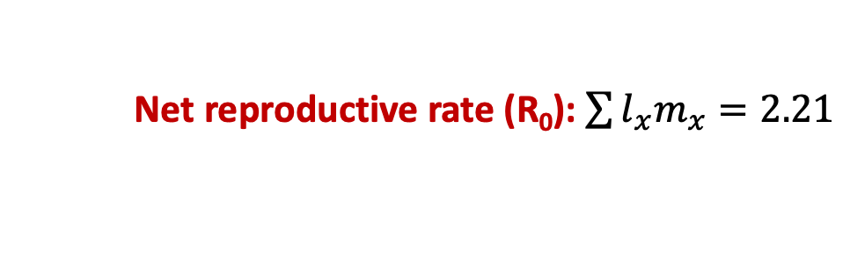
The structured
population model
F₃
F₄
F₂
Age₁
Age₂
Age₃
Age₄
Demographers collect these rates in life tables
s₁
s₂
s₃
x (age) | N_{x} (number in cohort) | l_{x} (survivorship to age x) | m_{x} (fecundity) | l_{x}m_{x}
0 | 100 | 1 | 0 | 0
1 | 60 | .6 | 2 | 1.2
2 | 30 | .3 | 3 | 0.9
3 | 10 | .1 | 1 | 0.1
4 | 1 | .01 | 1 | 0.01
x
=
Net reproductive rate (R₀): $\sum{l_{x}m_{x}=2.21}$
λ = ${R0}^{1/G}$ where G = length of a generation (often 1 year)

Slide 102
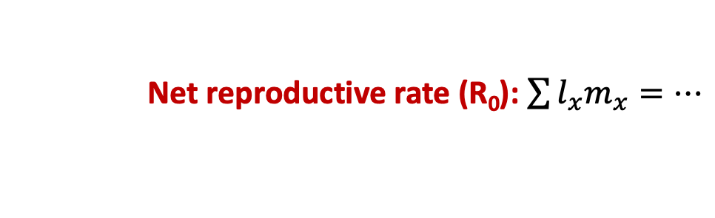
The structured
population model
F₃
F₄
F₂
Age₁
Age₂
Age₃
Age₄
s₁
s₂
s₃
x (age) | N_{x} (number in cohort) | l_{x} (survivorship to age x) | m_{x} (fecundity) | l_{x}m_{x}
0 | 100 | 1 | 0 | 0
1 | 60 | .6 | 2 | 1.2
2 | 30 | .3 | 3 | 0.9
3 | 10 | .1 | 1 | 0.1
4 | 1 | .01 | 1 | 0.01
x
=
…
Orange roughy can live up to 200 years!
Net reproductive rate (R₀): $\sum{l_{x}m_{x}=…}$

Slide 103


The structured
population model
F₃
F₄
F₂
Age₁
Age₂
Age₃
Age₄
s₁
s₂
s₃
Fecundity (eggs) increases in older, bigger fish!
Absolute fecundity (x10³)
Pankhurst & Conroy 1987
NZ J of Marine & Freshwater Res
Standard length (cm)
Net reproductive rate (R₀): $\sum{l_{x}m_{x}=…}$

Slide 104

The structured
population model
F₃
F₄
F₂
Age₁
Age₂
Age₃
Age₄
s₁
s₂
s₃
Fecundity (eggs) increases in older, bigger fish!
Absolute fecundity (x10³)
These are precisely the fish we like to catch! One of the problems with MSY…
Norway 1910
(Norsk folkemuseum)
Standard length (cm)

Slide 105
The structured
population model
F₃
F₄
F₂
Age₁
Age₂
Age₃
Age₄
s₁
s₂
s₃
Poor modeling projections has led to severe overexploitation, a common problem in fisheries…
In 2008, the international TAC for orange roughy was reduced from 1470 tons to 914 tons… down from over 90,000 tons in the early 1990s…

Slide 106

The structured
population model
F₃
F₄
F₂
Age₁
Age₂
Age₃
Age₄
Life table analysis is also used extensively in human demography.
s₁
s₂
s₃
Edmond Halley, 1693
“An estimate of the degrees of the mortality of mankind, drawn from curious tables of the births and funerals at the city of Breslau, with an attempt to ascertain the price of annuities upon lives…”
Notes:
Halley

Slide 107

The structured
population model
F₃
F₄
F₂
Age₁
Age₂
Age₃
Age₄
Population pyramid for Breslau
s₁
s₂
s₃
Edmond Halley, 1693
“An estimate of the degrees of the mortality of mankind, drawn from curious tables of the births and funerals at the city of Breslau, with an attempt to ascertain the price of annuities upon lives…”
Notes:
Halley

Slide 108



The structured
population model
F₃
F₄
F₂
Age₁
Age₂
Age₃
Age₄
Population pyramid for Breslau
s₁
s₂
s₃
Humans are not like fish!
Fecundity tends to decrease in older age classes due to reproductive senescence.
Younger human populations that start giving birth earlier grow faster!
A
N_{t}
N_{t+1}
$$\left[\begin{aligned}\begin{matrix}0 & F_{2} \\ s_{1} & 0\end{matrix} \begin{matrix}F_{3} & F_{4} \\ 0 & 0\end{matrix} \\ \begin{matrix}0 & s_{2} \\ 0 & 0\end{matrix} \begin{matrix} 0 & 0 \\ .{ s}_{3} & 0\end{matrix}\end{aligned}\right]$$
$$\left[\begin{matrix}\begin{matrix}N_{1} \\ N_{2}\end{matrix} \\ \begin{matrix}N_{3} \\ N_{4}\end{matrix}\end{matrix}\right]$$
$$\left[\begin{matrix}\begin{matrix}N_{1 t+1} \\ N_{2 t+1}\end{matrix} \\ \begin{matrix}N_{3 t+1} \\ N_{4.t+1}\end{matrix}\end{matrix}\right]$$
x
=
Notes:
Halley

Slide 109


The structured
population model
F₃
F₄
F₂
Age₁
Age₂
Age₃
Age₄
s₁
s₂
s₃
Humans are not like fish!
Fecundity tends to decrease in older age classes due to reproductive senescence.
Younger human populations that start giving birth earlier grow faster!
A
N_{t}
N_{t+1}
$$\left[\begin{aligned}\begin{matrix}0 & F_{2} \\ s_{1} & 0\end{matrix} \begin{matrix}F_{3} & F_{4} \\ 0 & 0\end{matrix} \\ \begin{matrix}0 & s_{2} \\ 0 & 0\end{matrix} \begin{matrix} 0 & 0 \\ .{ s}_{3} & 0\end{matrix}\end{aligned}\right]$$
$$\left[\begin{matrix}\begin{matrix}N_{1} \\ N_{2}\end{matrix} \\ \begin{matrix}N_{3} \\ N_{4}\end{matrix}\end{matrix}\right]$$
$$\left[\begin{matrix}\begin{matrix}N_{1 t+1} \\ N_{2 t+1}\end{matrix} \\ \begin{matrix}N_{3 t+1} \\ N_{4.t+1}\end{matrix}\end{matrix}\right]$$
x
=
Notes:
Total fertility rate = average number of offspring per woman

Slide 110

Notes:
Do not modify the notes in this section to avoid tampering with the Poll Everywhere activity. More info at polleverywhere.com/support Que. 2 The number of individuals in age class 3 in the next year is given by:
https://www.polleverywhere.com/multiple_choice_polls/mzLdr86glrEEOpW0rPfEk?state=opened&flow=Default&onscreen=persist

Slide 111

Demographic transition
Notes:
5 stages to a demographic transition – high pop growth in stage 2

Slide 112
Demographic transition
Notes:
5 stages to a demographic transition – high pop growth in stage 2

Slide 113

Demographic transition
Death rates are falling globally…

Slide 114

Demographic transition
And birth rates are also falling…

Slide 115

Demographic transition
Notes:
5 stages to a demographic transition – high pop growth in stage 2

Slide 116
Demographic transition
How does age structure predict population growth?
Notes:
5 stages to a demographic transition – high pop growth in stage 2

Slide 117

Demographic transition
How does age structure predict population growth?
Notes:
5 stages to a demographic transition – high pop growth in stage 2

Slide 118


Where are we globally?
Notes:
5 stages to a demographic transition – high pop growth in stage 2

Slide 119


Where are we globally?
Notes:
Declining death rates without declining birth rates

Slide 120

Where are we globally?

